Slide 1

Which design elements drive consumer appeal?
Dove Core Skin Cleansing Study Live Appeal Report | October 2026
Prepared by: J Brown Fitterman | jbrown@mindgenomicsassociates.com
Mind Genomics Associates, Inc
Dove Core Skin Cleansing Study Live

Slide 2
Inputs

Slide 3
The study in this report
Scores in the pages that follow come from this file.
Dove Core Skin Cleansing Study Live
14 silos · 69 elements
601 respondents
n=601 respondents. Top-2 Box model (ratings 4–5): element lifts show movement above or below the model baseline.
3

Slide 4
How the method works
Every respondent sees their own mix of design variations, and we learn what individually moves the appeal score.
01
We slice the design into unique elements
Each element is one design choice — Deboss, Imagery, Variant, Derm Seal, Loz Low Ctr, Loz Top Ctr Low, Loz Top Ctr, Loz Top Left Low, Loz Top Left, Advanced Care, Wordmark, Bird Treatment, Gold Foil Band, and Cap Color.
02
Each element has 3–9 possible variations
Like the small choices a designer would make between the options in a silo.
03
Each respondent sees a set of pack designs
Each pack is a unique combination of variations — never quite the same as anyone else’s.
04
They rate each one
The same rating scale is used on every task. The variation does the work.
05
We learn what drives the rating
The model separates the baseline from the movement each element creates, on its own.
n=601 respondents. Top-2 Box model (ratings 4–5): element lifts show movement above or below the model baseline.
4

Slide 5
Design elements
14 design silos, 69 element variations in total.
A
Deboss
3
B
Imagery
9
C
Variant
6
D
Derm Seal
8
Deboss Off, Deboss Blue, Deboss On
Dollop High, Dollop Low, +7
Variant Ctr Low, +5
Derm Seal Gold Std, +7
E
Loz Low Ctr
5
F
Loz Top Ctr Low
5
G
Loz Top Ctr
5
H
Loz Top Left Low
5
Loz Gold Fill Low Ctr, +4
Loz Gold Fill Top Ctr Low, +4
Loz Gold Fill Top Ctr, +4
Loz Variant Fill Top Left Low, +4
I
Loz Top Left
5
J
Advanced Care
4
K
Wordmark
4
L
Bird Treatment
4
Loz Text Top Left, +4
Adv Care Caps No Wordmark, +3
Wordmark 100%, Wordmark 60%, +2
Bird Gold Cold Foil, Bird Gold Gravure, +2
M
Gold Foil Band
3
N
Cap Color
3
Gold Band Off, Gold Band On, +1
Cap Gold, Cap Pearl White, +1
Each card shows the silo letter, the element count, and a sample of the options.
n=601 respondents. Top-2 Box model (ratings 4–5): element lifts show movement above or below the model baseline.
5

Slide 6
WHAT YOU GET BACK
What design elements drive pack appeal?
01
02
Combination winners
Category winners
The strongest option in each group, shown together, against a weaker combination of the same groups.
The winning element in every category, so the same read works one category at a time.
03
04
Element winners
Base appeal
Every element inside its category, with the score used in the charts.
The Top-2 Box intercept. The pack’s starting appeal before a single element is added.
n=601 respondents. Top-2 Box model (ratings 4–5): element lifts show movement above or below the model baseline.
6

Slide 7
Reading The Scores – What The Coefficients Mean
1
Element Lift Scores
Element lifts show the estimated movement each design choice creates above or below the model baseline.
2
Explore Combinations
3
Reading The Scale
These scores can be combined to explore multiple design scenarios.
Coefficient Interpretation
Coefficient Scale | Interpretation
+10 or higher | Strong lift
+5 to +9.9 | Moderate lift
+2 to +4.9 | Small lift
Below +2 | Minimal / weak lift
n=601 respondents. Top-2 Box model (ratings 4–5): element lifts show movement above or below the model baseline.
7

Slide 8
Key Findings

Slide 9
KEY FINDINGS
Where appeal moves
The read starts with the winning combination, then the winner in each category, then every element in that category.
01
The model has a clear starting point
This Top-2 Box model was fit without an intercept. Each element score is the lift on its own.
02
Variant Ctr Low is the strongest single cue
In Variant, Variant Ctr Low moves appeal by +29. 69 of 69 elements sit above the baseline.
03
Variant is the lead design area
Variant Ctr Low tops this silo at +29. Imagery has the widest spread, +16 points from Swipe Low to Splash High.
04
Deboss Off is the largest drag
In Deboss, Deboss Off sits at +1. Negative lifts pull the appeal score below the model baseline.
n=601 respondents. Top-2 Box model (ratings 4–5): element lifts show movement above or below the model baseline.
9

Slide 10
MODEL OVERVIEW: BASE APPEAL
Base appeal before element lift
Base appeal is this model’s starting Top-2 Box score (ratings 4–5) before individual design elements add or subtract lift.
BASE APPEAL
HOW TO USE IT
Dove Core Skin Cleansing Study Live
Each element chart is movement around this number, not a new total by itself.
No intercept
A build-up adds the baseline and one lift from each silo. That sum is a model scenario. It is not capped at 0 or 100.
Element scores are the lift on their own
Base size 601
n=601 respondents. Top-2 Box model (ratings 4–5): element lifts show movement above or below the model baseline.
10

Slide 11
Combination Winners

Slide 12
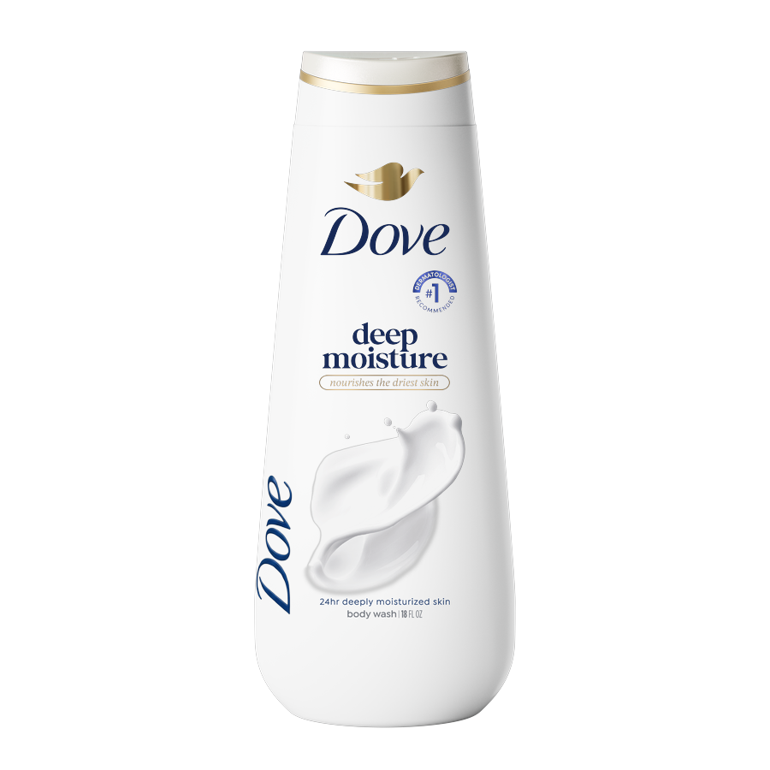
COMBINATION WINNERS
Highest coefficient sum, stacked into one pack
The highest coefficient sum that still obeys the pairing rules. A stronger element is left off when the elements it blocks add up to more.
01 DEBOSS
+7
Deboss Blue
02 IMAGERY
+14
Splash Low
03 VARIANT
+21
Variant Ctr Top Lowered
04 DERM SEAL
+8
Derm Seal Variant High
05 LOZ TOP CTR LOW
+22
Loz Gold Outline Top Ctr Low
06 WORDMARK
+14
Wordmark 100%
07 BIRD TREATMENT
+7
Bird Gold Cold Foil
+100
08 GOLD FOIL BAND
+3
Gold Band On
coefficient sum
09 CAP COLOR
+4
Cap Pearl White
n=601 respondents. Top-2 Box model (ratings 4–5): element lifts show movement above or below the model baseline.
12

Slide 13
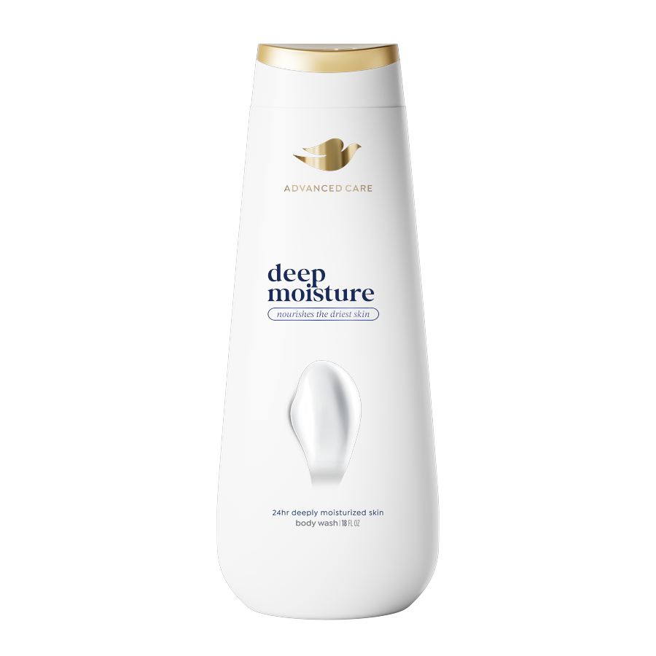
COMBINATION WINNERS
Lowest coefficient sum, stacked into one pack
The lowest coefficient sum that still fills every silo it can, with no blocked pair on the pack.
01 DEBOSS
+1
Deboss Off
02 IMAGERY
+8
Swipe Low
03 VARIANT
+19
Variant Left Top
04 LOZ TOP LEFT
+20
Loz Variant Outline Top Left
05 ADVANCED CARE
+6
Adv Care Caps No Wordmark
06 BIRD TREATMENT
+7
Bird Gold Cold Foil
07 GOLD FOIL BAND
+1
+64
Gold Band Off
coefficient sum
08 CAP COLOR
+2
Cap Gold
n=601 respondents. Top-2 Box model (ratings 4–5): element lifts show movement above or below the model baseline.
13

Slide 14
COMBINATION WINNERS
The higher-lift build against the lower-lift build
HIGHER-LIFT BUILD
LOWER-LIFT BUILD
+100
+64
Lift only, no separate base
Lift only, no separate base
Deboss
Blue
+7
Deboss
Off
+1
Imagery
Splash Low
+14
Imagery
Swipe Low
+8
Variant
Ctr Top Lowered
+21
Variant
Left Top
+19
Derm Seal
Variant High
+8
Loz Top Left
Loz Variant Outline Top Left
+20
Loz Top Ctr Low
Loz Gold Outline Top Ctr Low
+22
Advanced Care
Adv Care Caps No Wordmark
+6
Wordmark
100%
+14
Bird Treatment
Bird Gold Cold Foil
+7
Bird Treatment
Bird Gold Cold Foil
+7
Gold Foil Band
Gold Band On
+3
Gold Foil Band
Gold Band Off
+1
Cap Color
Cap Pearl White
+4
Cap Color
Cap Gold
+2
The higher-lift build leads by +36 points. This model has no intercept, so the totals are the element lifts. Both totals are the highest and lowest sums that still obey the pairing rules.
n=601 respondents. Top-2 Box model (ratings 4–5): element lifts show movement above or below the model baseline.
14

Slide 15
Category Winners

Slide 16
CATEGORY WINNERS
Appeal moves most clearly
in four design areas
These are the silos where one element, or the gap inside the silo, moves appeal the most.
ROADMAP FOR THE READ
01
02
03
04
Variant
Loz Top Left Low
Imagery
Loz Top Ctr
Variant Ctr Low leads at +29.
Low end is Variant Left Top Lowered.
Loz Variant Fill Top Left Low leads at +25.
Low end is Loz Text Top Left Low.
Splash High leads at +24.
Low end is Swipe Low.
Loz Gold Fill Top Ctr leads at +24.
Low end is Loz Variant Fill Top Ctr.
The clearest appeal movement is concentrated in Variant, Loz Top Left Low, Imagery, and Loz Top Ctr.
n=601 respondents. Top-2 Box model (ratings 4–5): element lifts show movement above or below the model baseline.
16

Slide 17
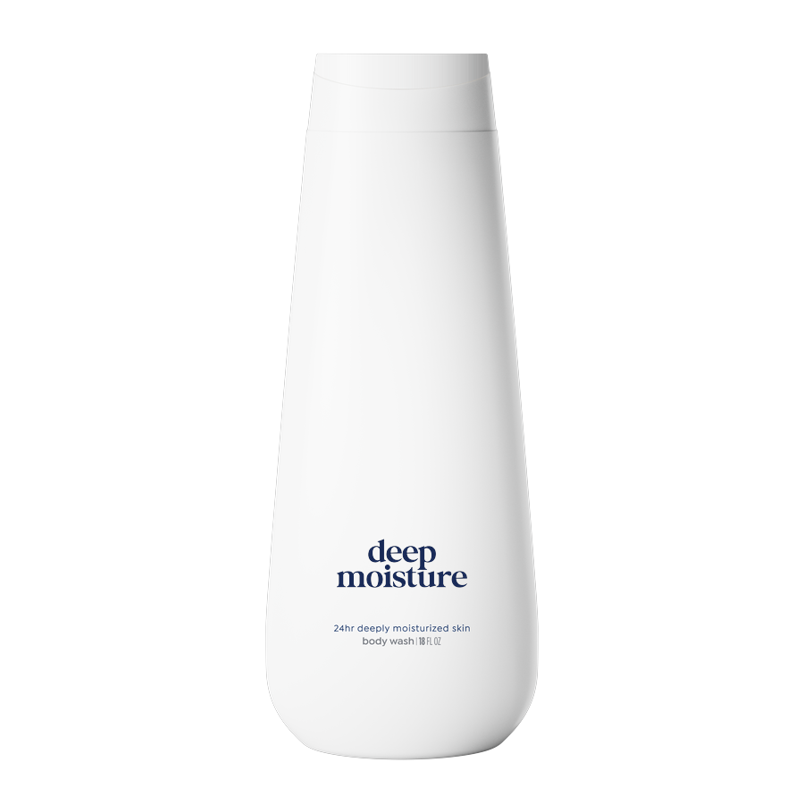
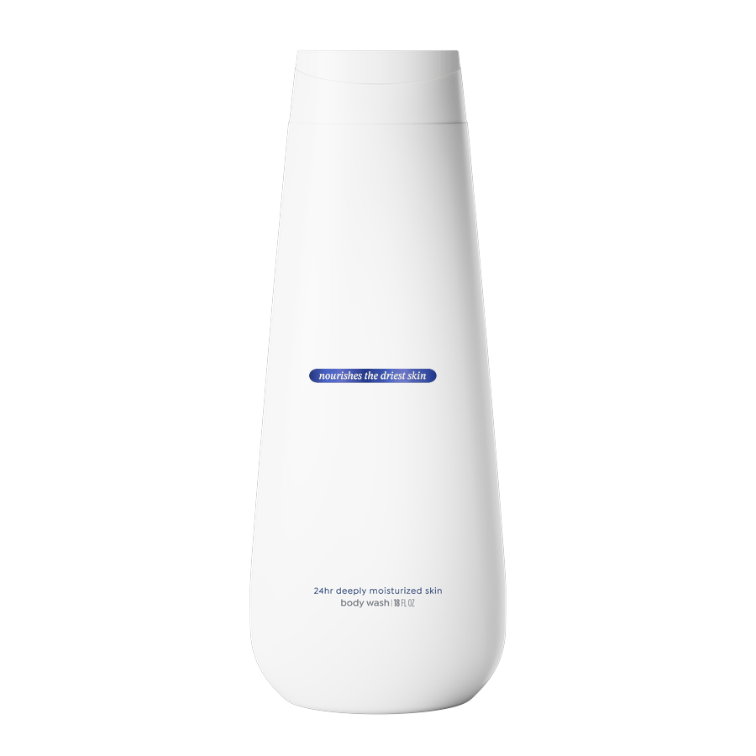
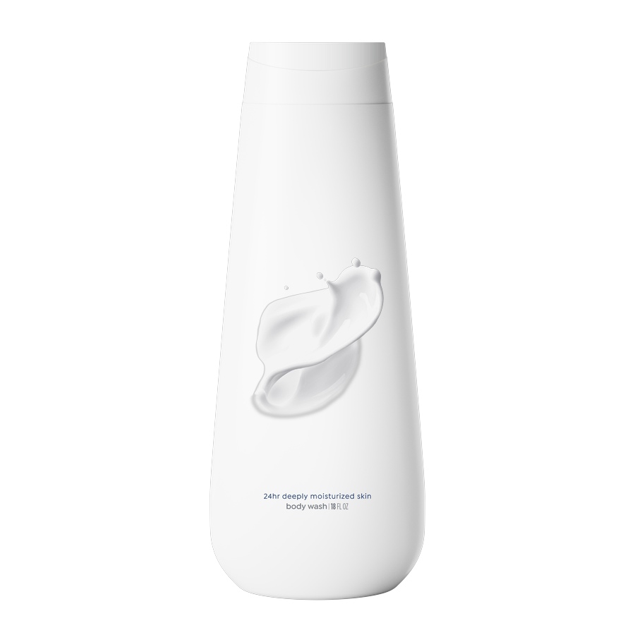
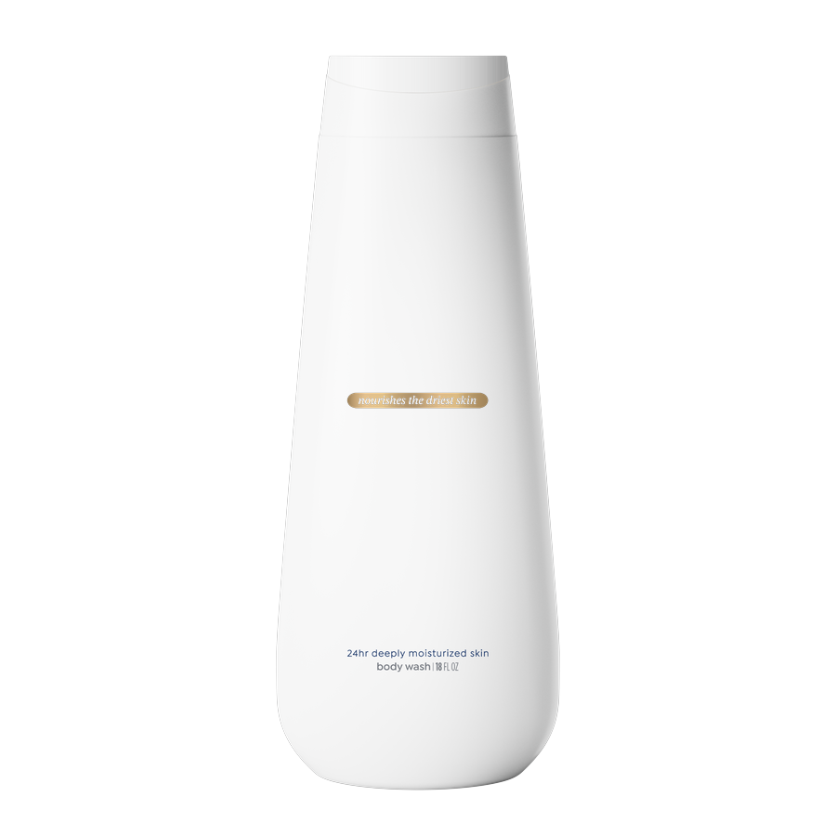
CATEGORY WINNERS · 1 of 4
The winning element in each category
Ranked by the total sample. The notes are the winners for “Do you currently use dove”.
VARIANT
Off the pack
+29
Variant Ctr Low
Non-users · Variant Left Low +27
Dove users · Variant Ctr Low +34
LOZ TOP LEFT LOW
Off the pack
+25
Loz Variant Fill Top Left Low
Both groups agree
IMAGERY
Off the pack
+24
Splash High
Both groups agree
LOZ TOP CTR
Off the pack
+24
Loz Gold Fill Top Ctr
Both groups agree
n=601 respondents. Top-2 Box model (ratings 4–5): element lifts show movement above or below the model baseline.
17

Slide 18
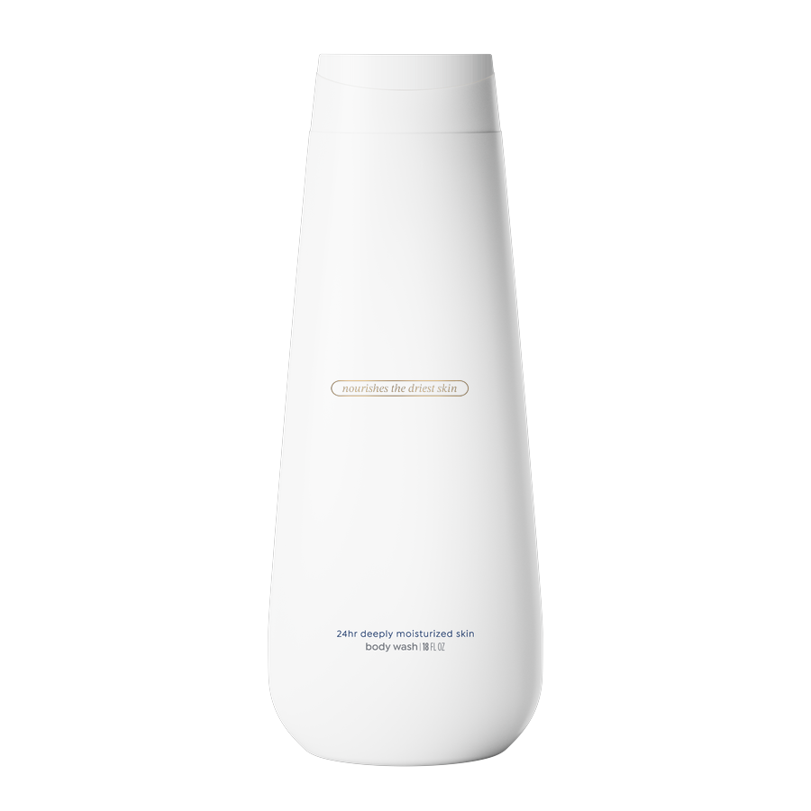
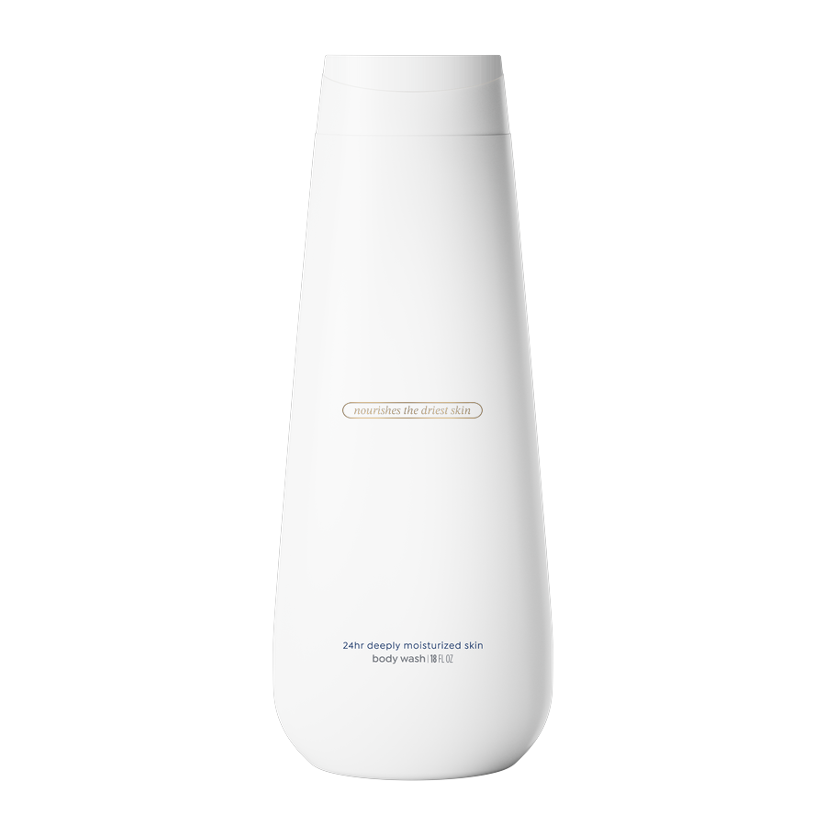
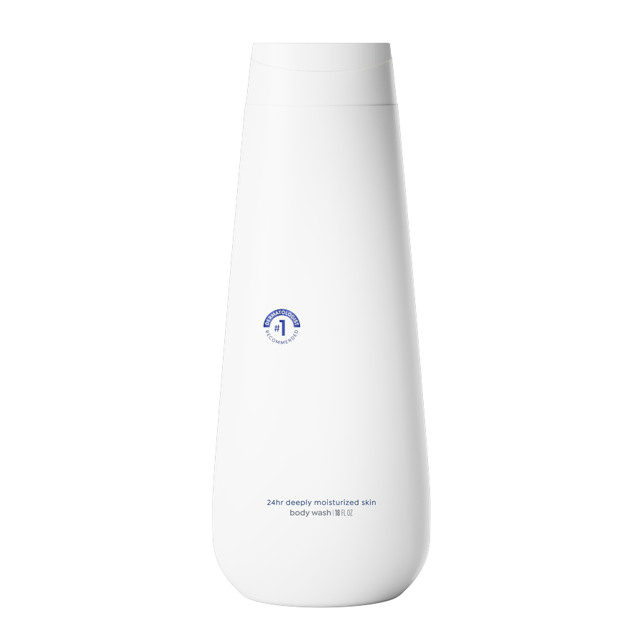
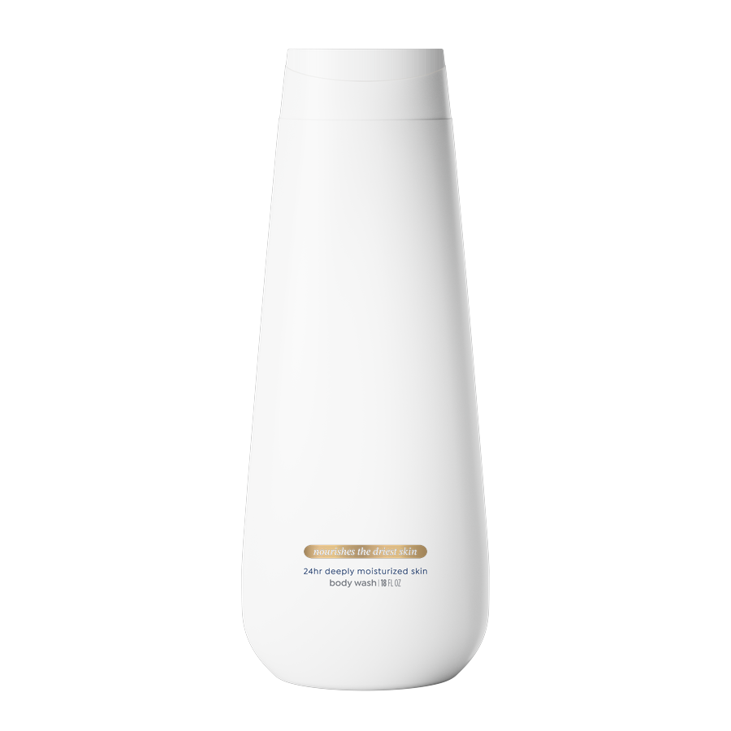
CATEGORY WINNERS · 2 of 4
The winning element in each category
Ranked by the total sample. The notes are the winners for “Do you currently use dove”.
LOZ TOP LEFT
Off the pack
+23
Loz Gold Outline Top Left
Non-users · Loz Gold Outline Top Left +19
Dove users · Loz Text Top Left +27
LOZ TOP CTR LOW
+22
Loz Gold Outline Top Ctr Low
Non-users · Loz Gold Outline Top Ctr Low +19
Dove users · Loz Variant Fill Top Ctr Low +27
DERM SEAL
Off the pack
+18
Derm Seal Variant Top Left
Both groups agree
LOZ LOW CTR
Off the pack
+17
Loz Gold Fill Low Ctr
Non-users · Loz Gold Outline Low Ctr +13
Dove users · Loz Gold Fill Low Ctr +22
n=601 respondents. Top-2 Box model (ratings 4–5): element lifts show movement above or below the model baseline.
18

Slide 19
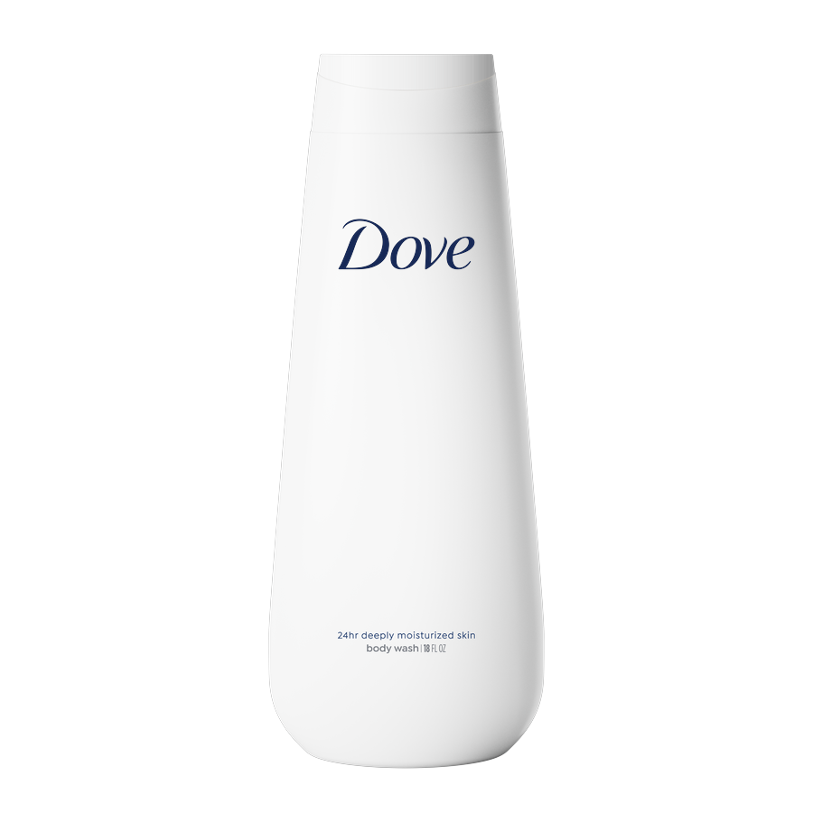
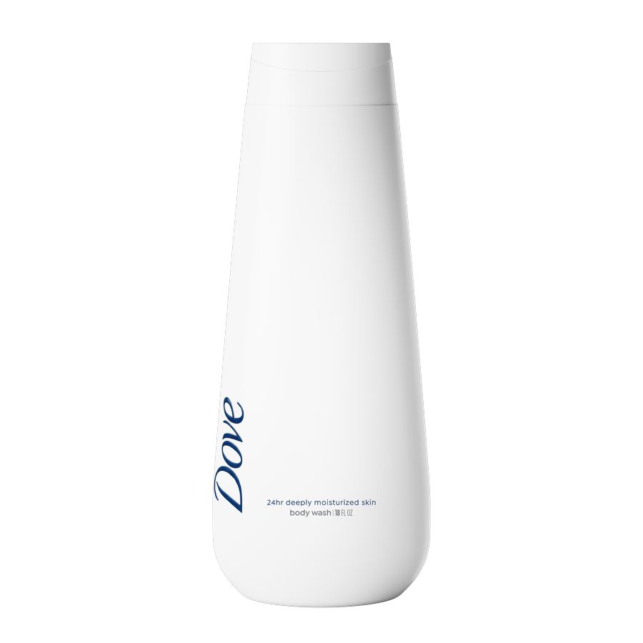
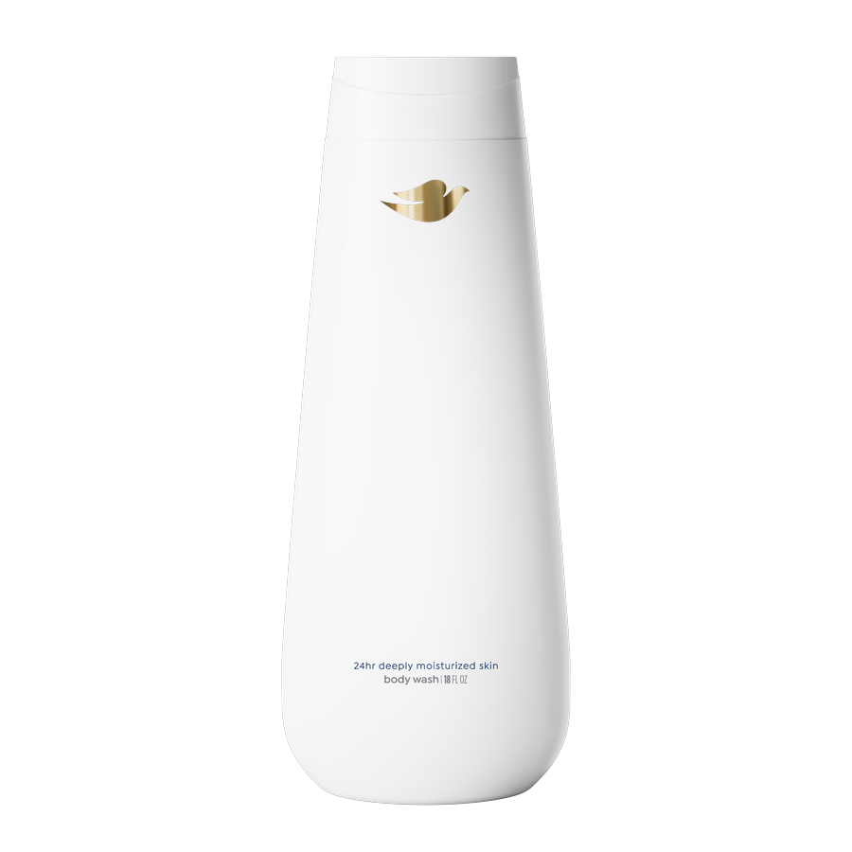
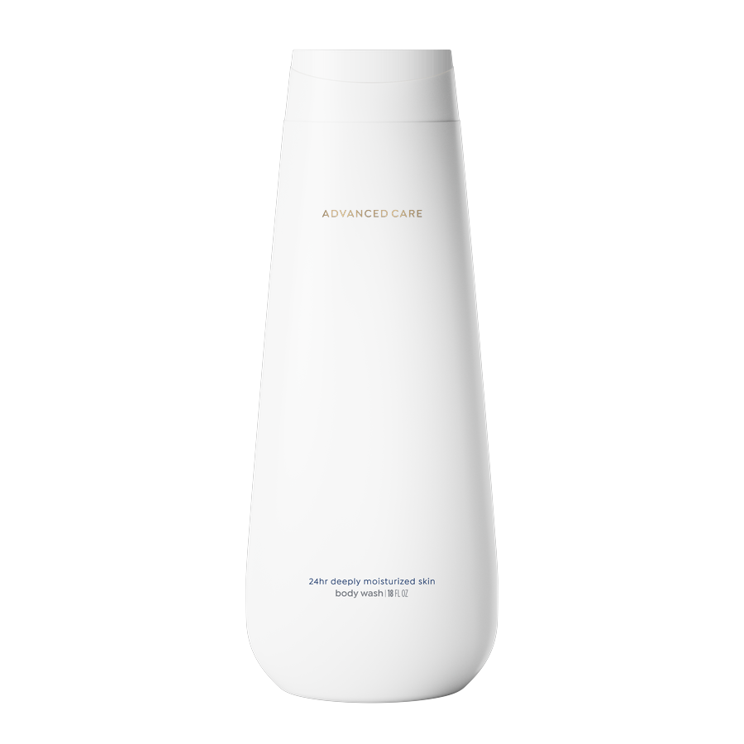
CATEGORY WINNERS · 3 of 4
The winning element in each category
Ranked by the total sample. The notes are the winners for “Do you currently use dove”.
WORDMARK
+14
Wordmark 100%
Both groups agree
DEBOSS
+7
Deboss Blue
Both groups agree
BIRD TREATMENT
+7
Bird Gold Cold Foil
Non-users · Bird Variant Gravure +7
Dove users · Bird Gold Cold Foil +9
ADVANCED CARE
Off the pack
+6
Adv Care Caps No Wordmark
Non-users · Adv Care Lowercase No Wordmark +5
Dove users · Adv Care Caps No Wordmark +8
n=601 respondents. Top-2 Box model (ratings 4–5): element lifts show movement above or below the model baseline.
19

Slide 20
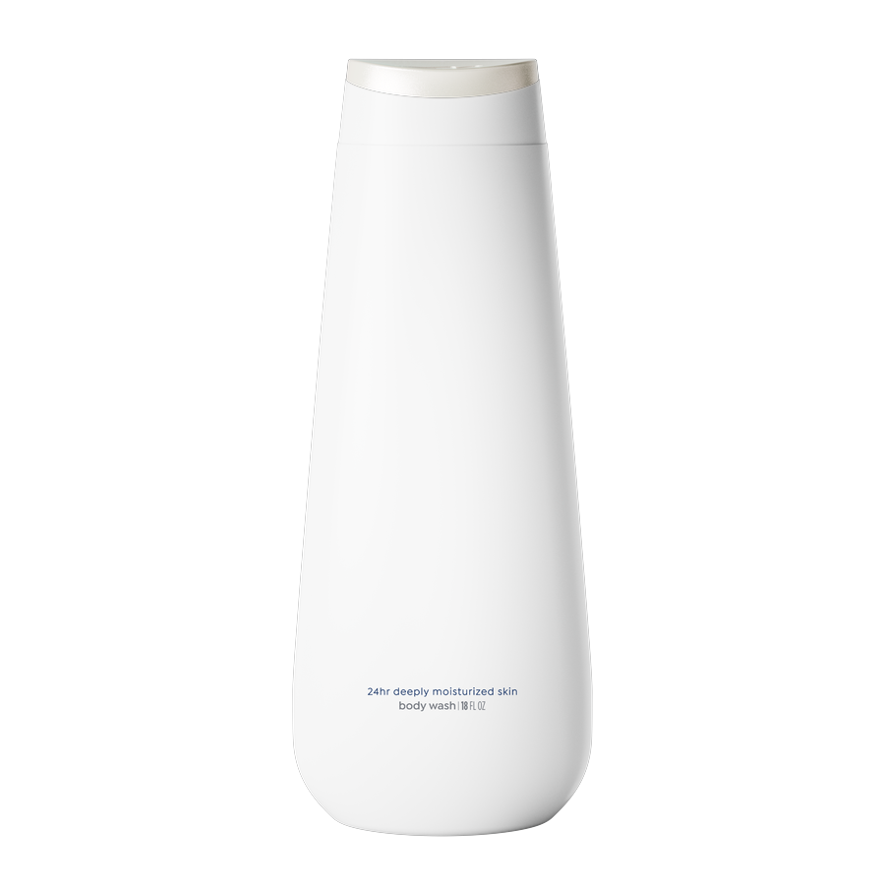
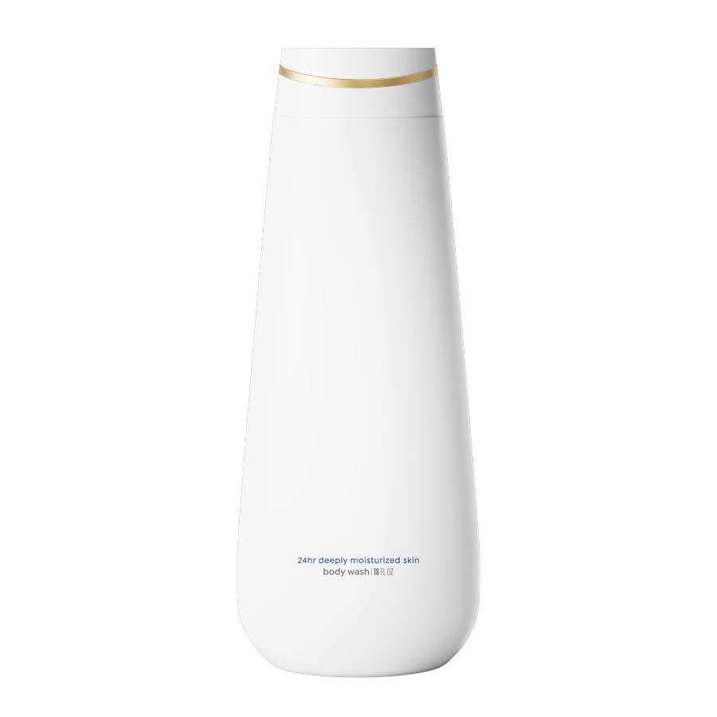
CATEGORY WINNERS · 4 of 4
The winning element in each category
Ranked by the total sample. The notes are the winners for “Do you currently use dove”.
CAP COLOR
+4
Cap Pearl White
Both groups agree
GOLD FOIL BAND
+3
Gold Band On
Both groups agree
n=601 respondents. Top-2 Box model (ratings 4–5): element lifts show movement above or below the model baseline.
20

Slide 21
Element Winners

Slide 22

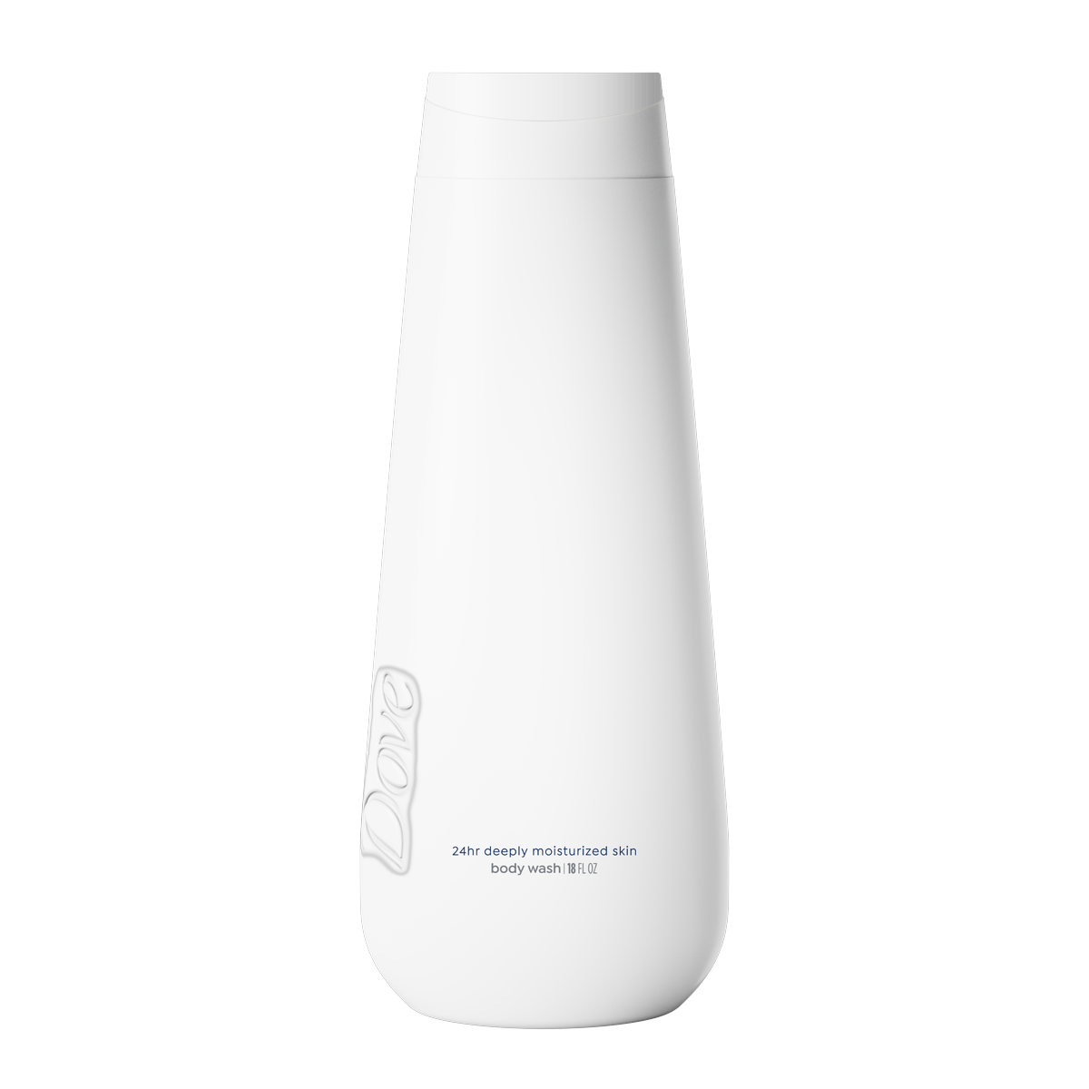
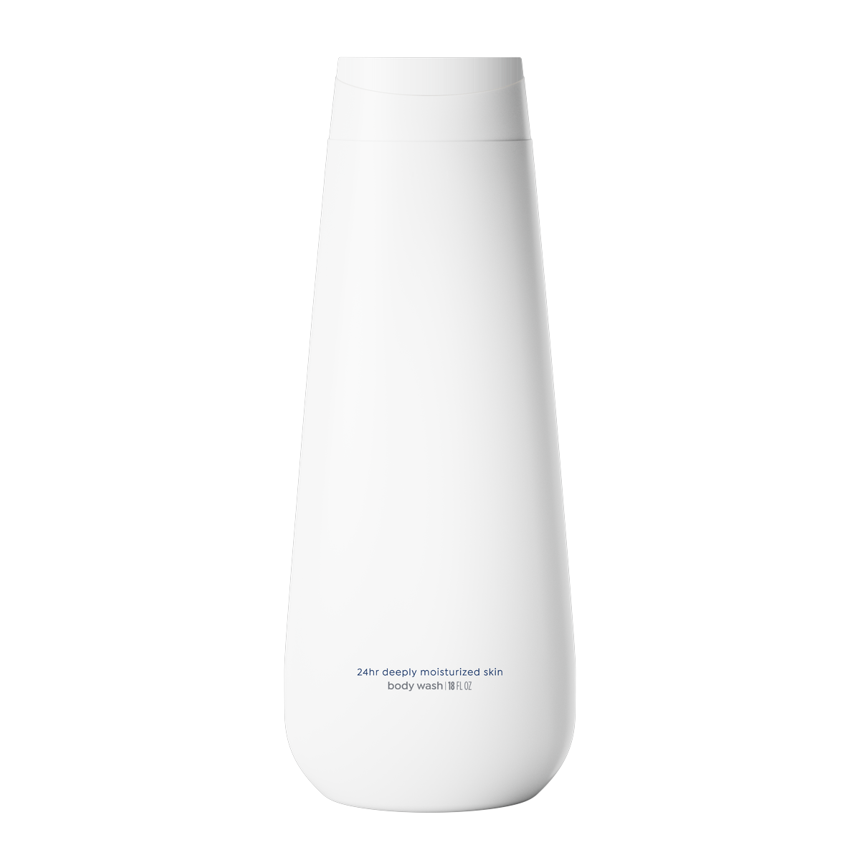
ELEMENT WINNERS: DEBOSS
Deboss Blue leads in both groups
Deboss Blue leads both groups; Deboss Off ranks last.
DEBOSS
Deboss Blue
+8*
Deboss Blue
+5
+10
Deboss On
+3
Deboss On
+4
+4*
Deboss Off
+1
+2
0
5
10
Deboss Off
+2*
Non-users (basesize = 308)
Dove users (basesize = 293)
Both groups rank Deboss Blue first. The widest segment gap is Deboss Blue: +5 non-users / +10 users.
Non-users basesize = 308; Dove users basesize = 293. Top-2 scores rounded to whole points. *Average of the groups in the legend.
22

Slide 23

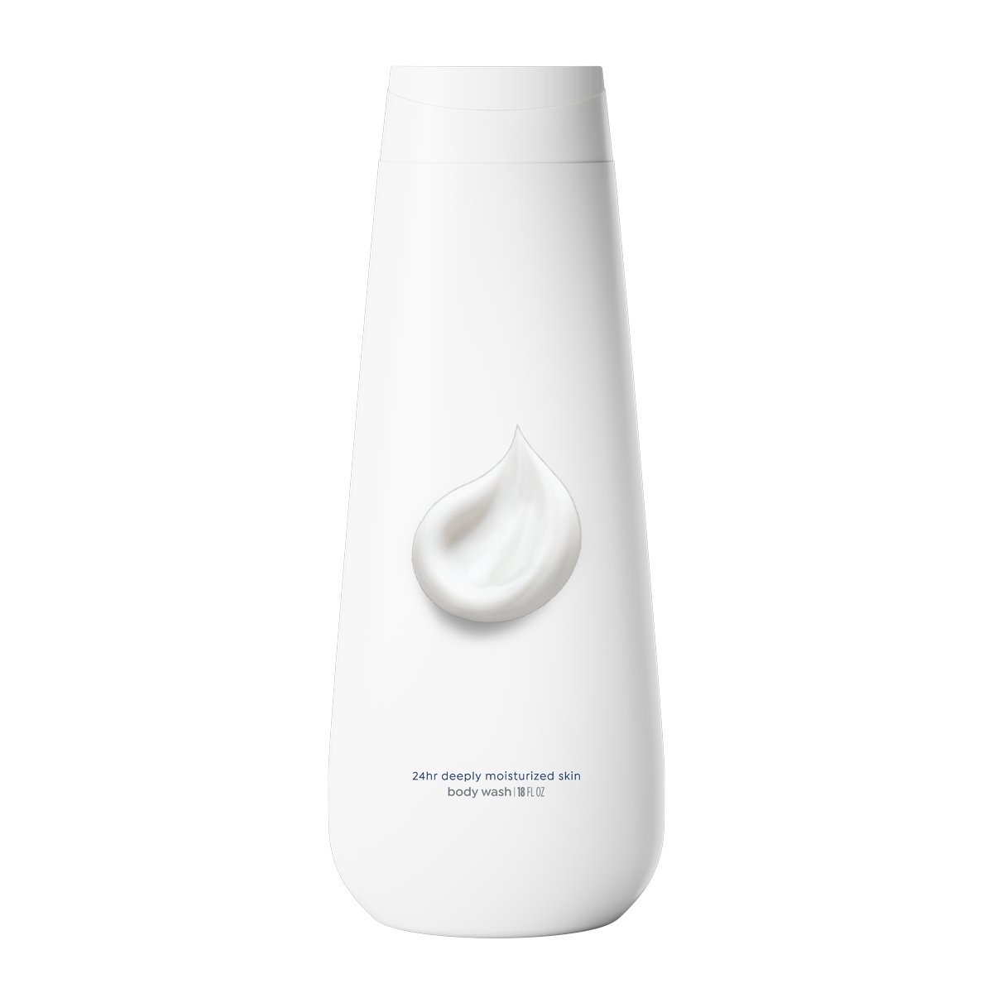
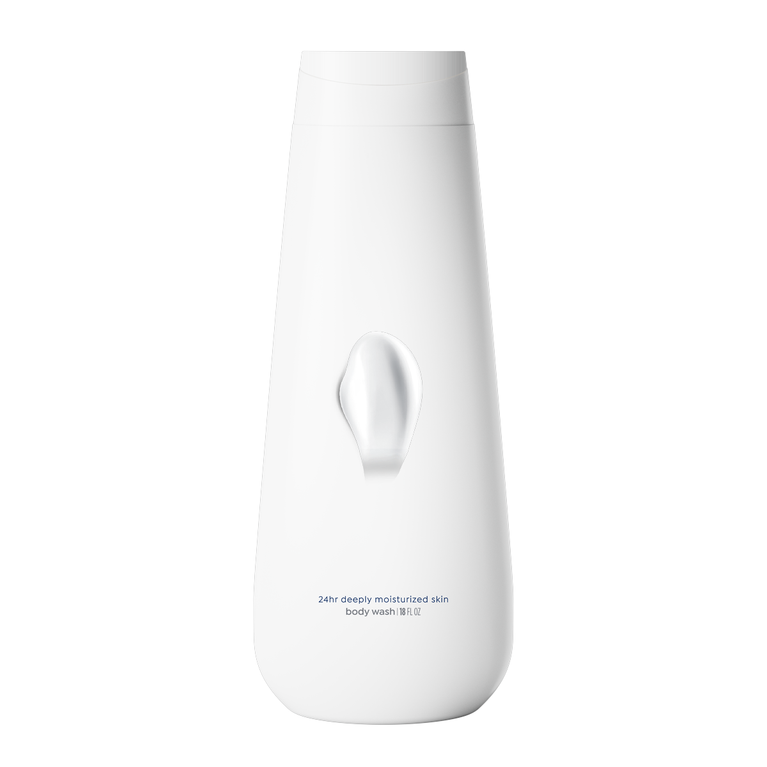
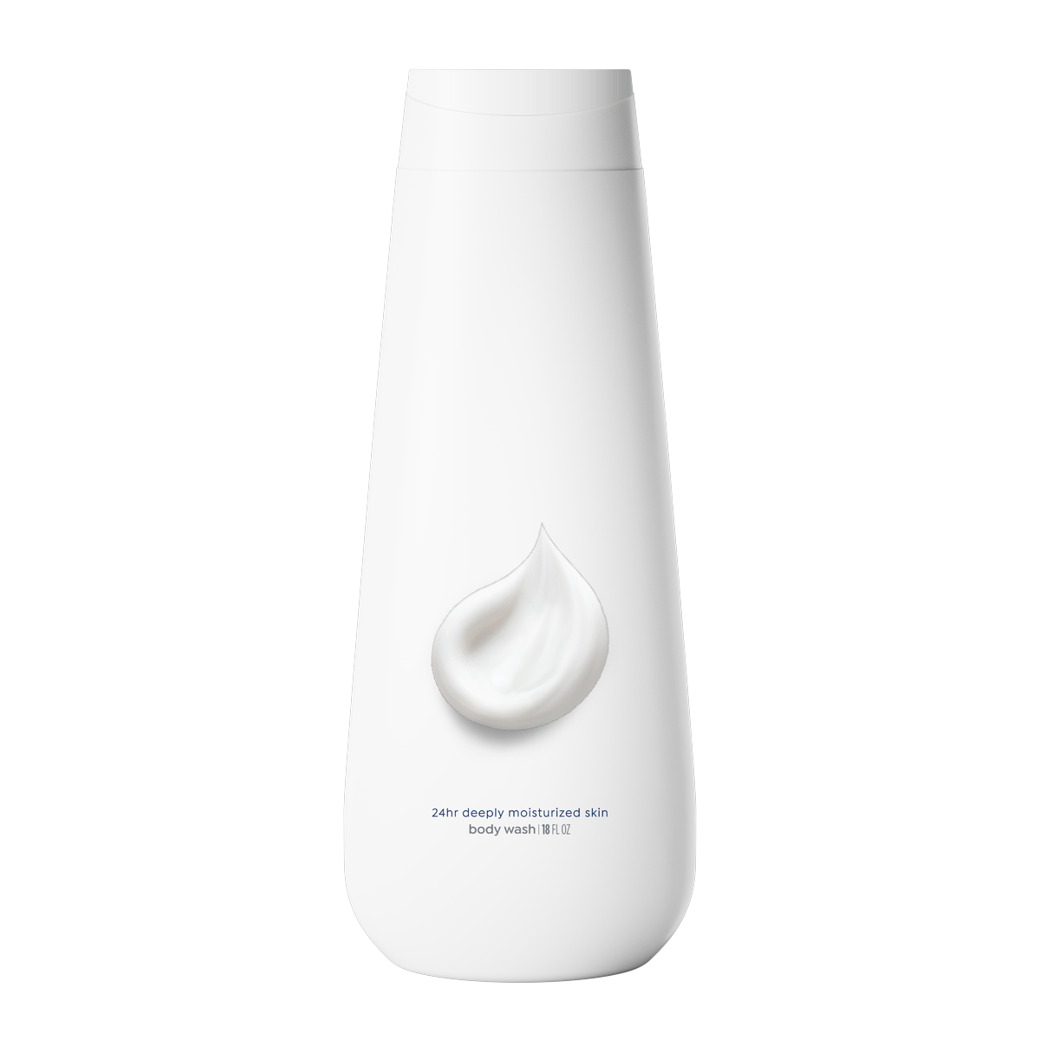
ELEMENT WINNERS: IMAGERY · 1 of 3
Splash High leads in both groups
Splash High leads both groups; Swipe Low ranks last.
IMAGERY
Splash High
+20
+27
Splash High
Dollop High
+24*
+21*
Dollop High
+17
+25
Swipe High
+14
+24
Dollop Standard
+18
+21
Swipe High
Dollop Standard
0
10
20
30
40
+19*
+20*
Non-users (basesize = 308)
Dove users (basesize = 293)
Both groups rank Splash High first. The widest segment gap is Swipe High: +14 non-users / +24 users.
Non-users basesize = 308; Dove users basesize = 293. Top-2 scores rounded to whole points. *Average of the groups in the legend.
23

Slide 24
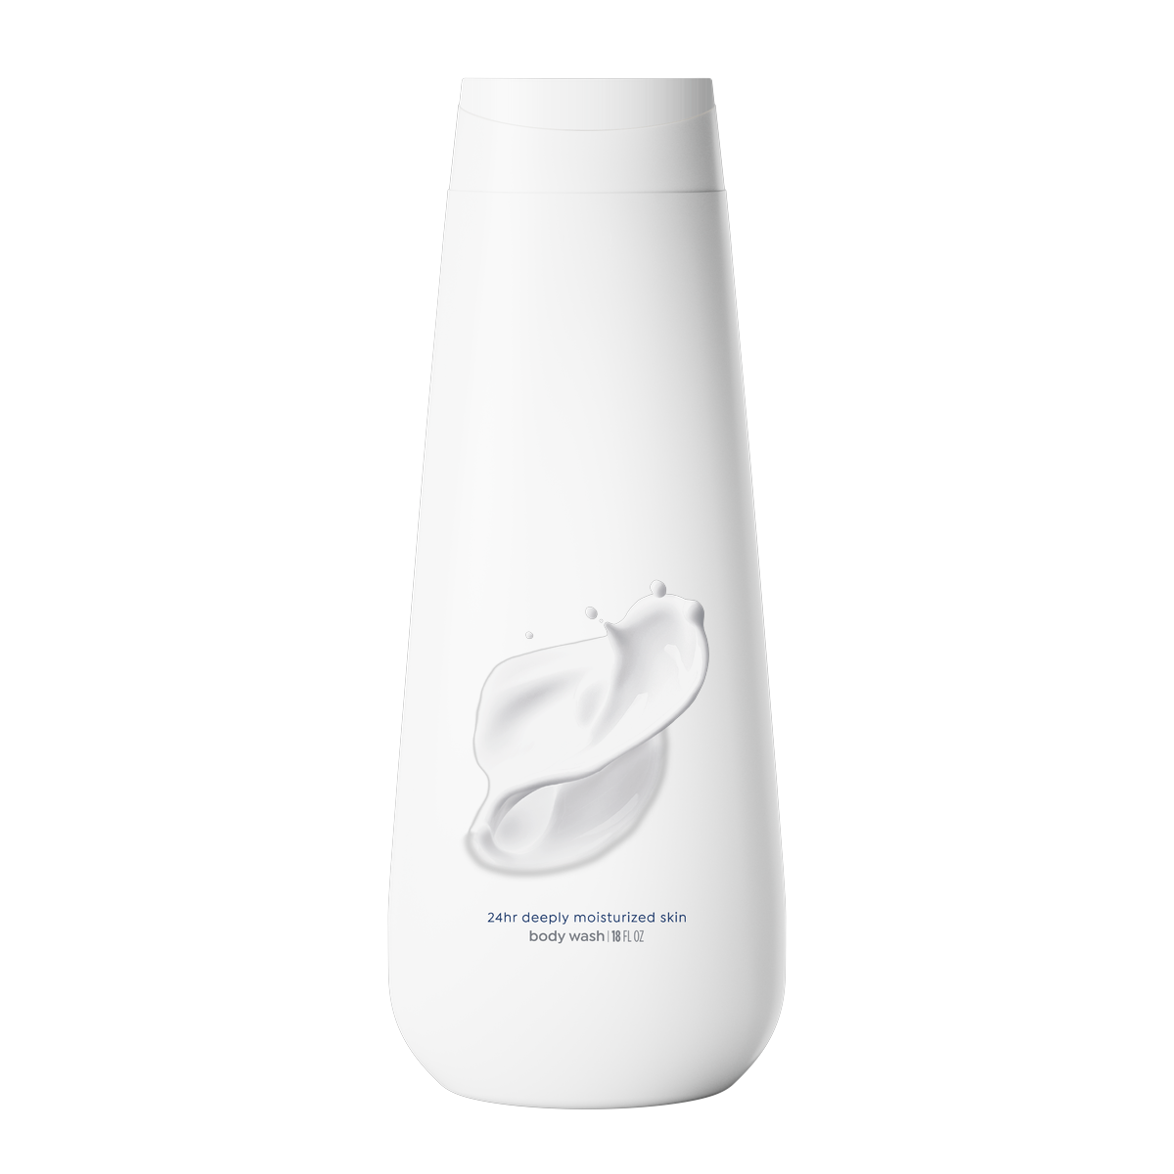
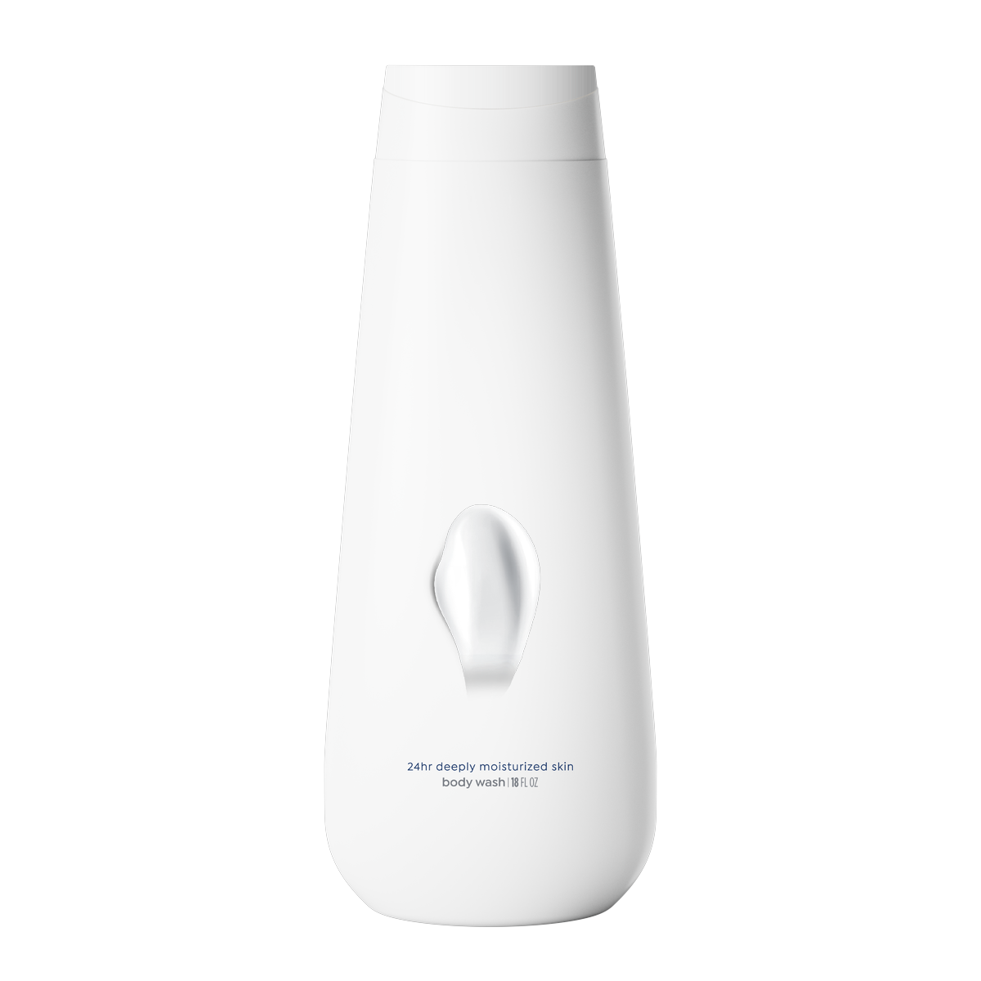
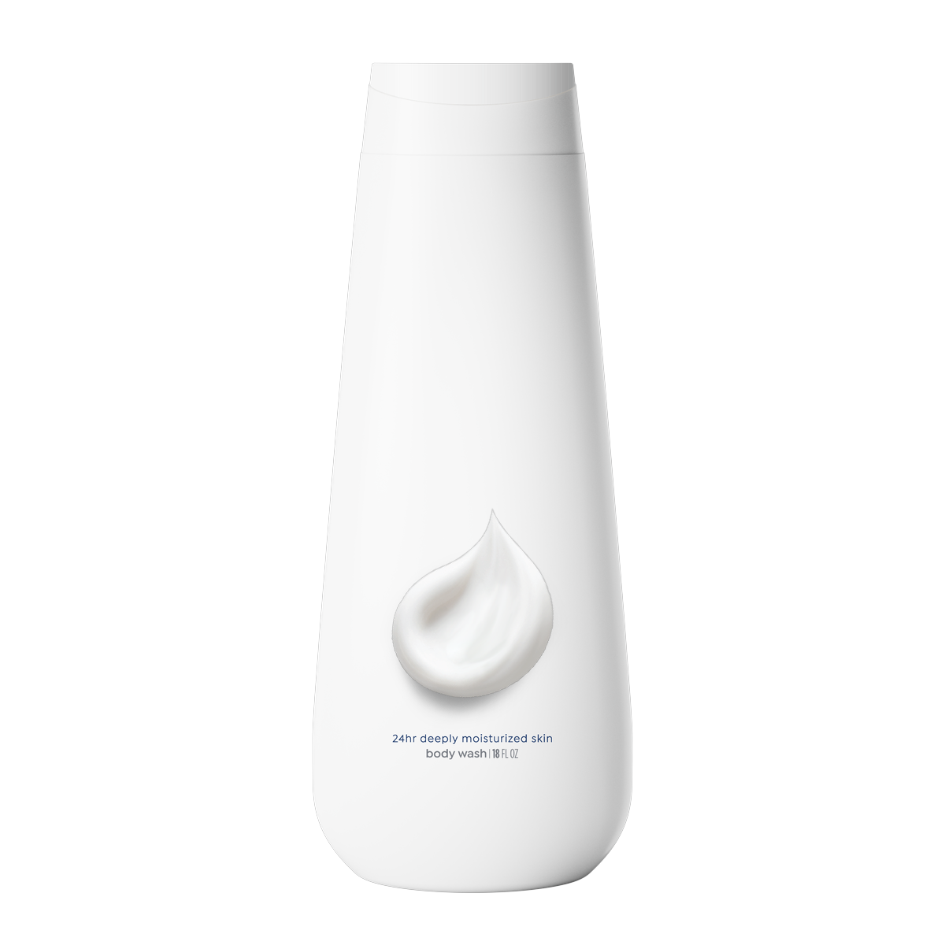
ELEMENT WINNERS: IMAGERY · 2 of 3
Splash High leads in both groups
Splash High leads both groups; Swipe Low ranks last.
IMAGERY
Splash Standard
+19*
Splash Standard
+18
+20
Swipe Standard
+11
Swipe Standard
+15
+13*
Dollop Low
+9
+14
0
5
10
15
20
Dollop Low
+12*
Non-users (basesize = 308)
Dove users (basesize = 293)
Both groups rank Splash High first. The widest segment gap is Swipe High: +14 non-users / +24 users.
Non-users basesize = 308; Dove users basesize = 293. Top-2 scores rounded to whole points. *Average of the groups in the legend.
24

Slide 25
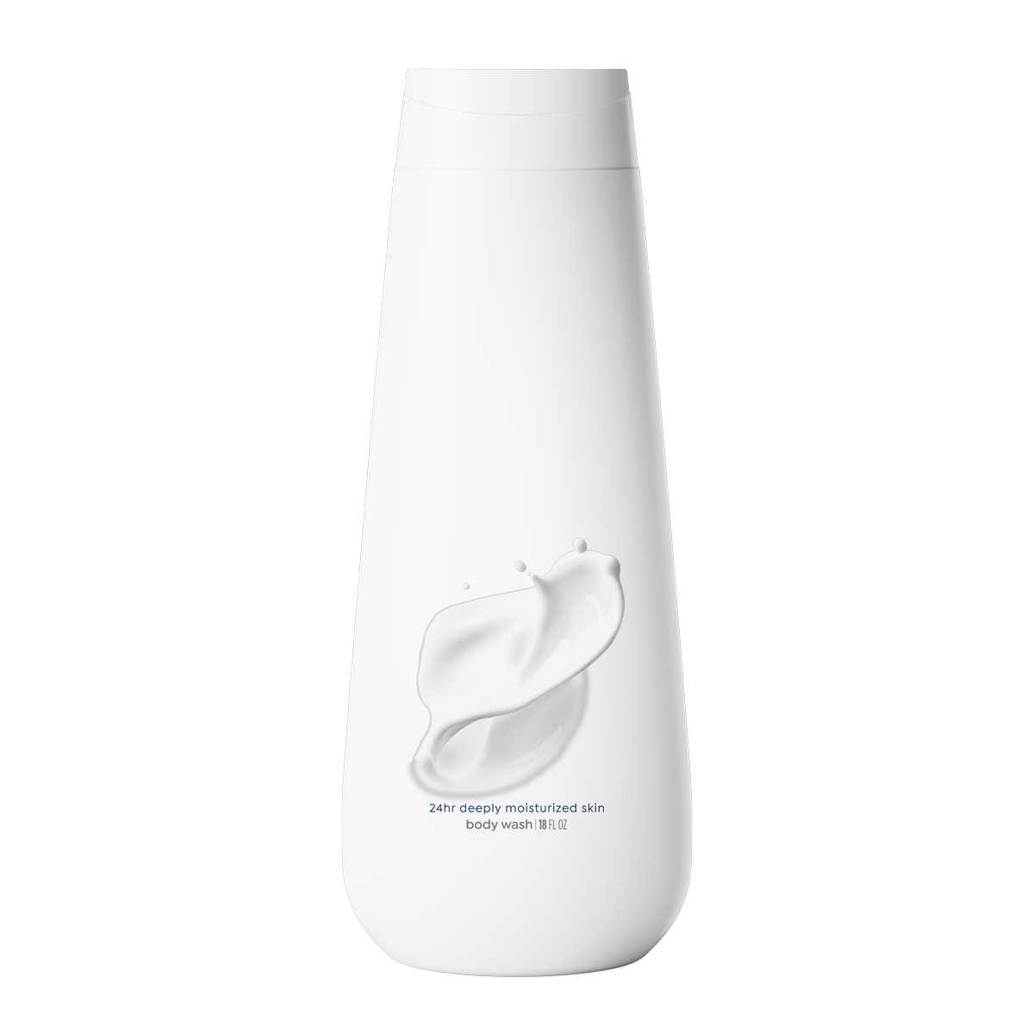
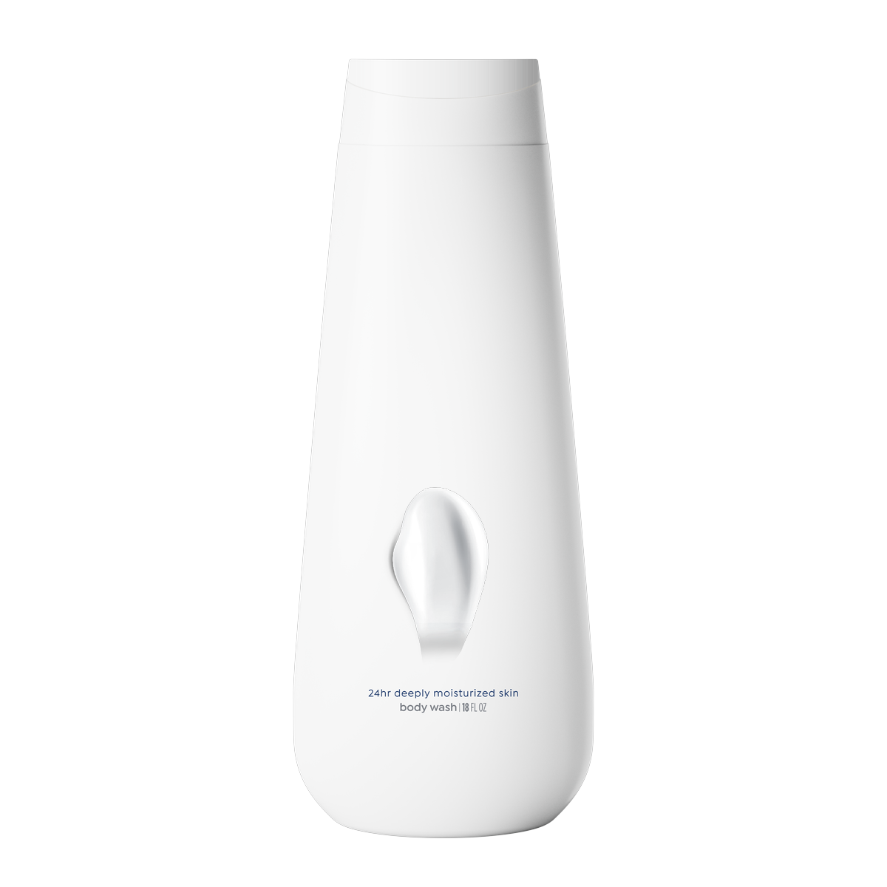
ELEMENT WINNERS: IMAGERY · 3 of 3
Splash High leads in both groups
Splash High leads both groups; Swipe Low ranks last.
IMAGERY
Splash Low
+13
+14
Splash Low
Swipe Low
+14*
+8*
Swipe Low
+8
+9
0
5
10
15
20
Non-users (basesize = 308)
Dove users (basesize = 293)
Both groups rank Splash High first. The widest segment gap is Swipe High: +14 non-users / +24 users.
Non-users basesize = 308; Dove users basesize = 293. Top-2 scores rounded to whole points. *Average of the groups in the legend.
25

Slide 26
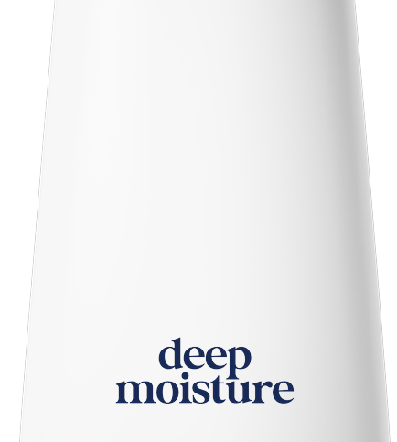
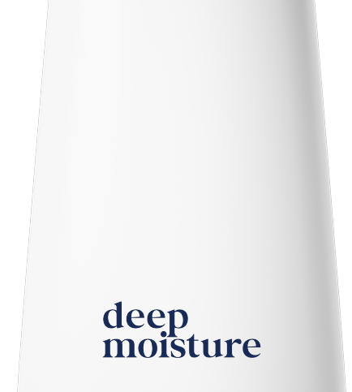
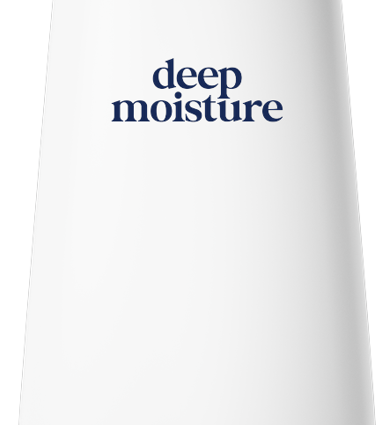
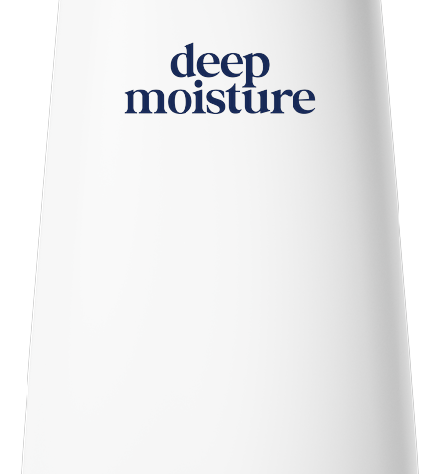
ELEMENT WINNERS: VARIANT · 1 of 2
Variant splits across the groups
Non-users favor Variant Left Low; Dove users favor Variant Ctr Low.
VARIANT
Variant Ctr Low
+25
+34
Variant Ctr Low
Variant Left Low
Variant Left Low
+27
+30*
+28*
+30
Variant Ctr Top
Lowered
+22
+20
Variant Ctr Top
+20
+18
Variant Ctr Top
Lowered
Variant Ctr Top
0
10
20
30
40
+21*
+19*
Non-users (basesize = 308)
Dove users (basesize = 293)
Non-users favor Variant Left Low; Dove users favor Variant Ctr Low. The widest segment gap is Variant Ctr Low: +25 non-users / +34 users.
Non-users basesize = 308; Dove users basesize = 293. Top-2 scores rounded to whole points. *Average of the groups in the legend.
26

Slide 27
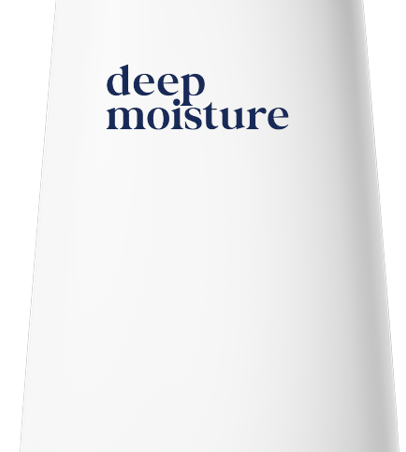
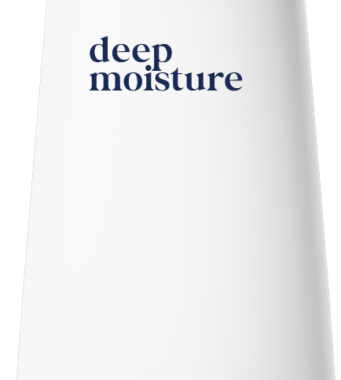
ELEMENT WINNERS: VARIANT · 2 of 2
Variant splits across the groups
Non-users favor Variant Left Low; Dove users favor Variant Ctr Low.
VARIANT
Variant Left Top
Lowered
+19
+18
Variant Left Top
Lowered
Variant Left Top
Variant Left Top
+18
+18*
+18*
+19
0
5
10
15
20
Non-users (basesize = 308)
Dove users (basesize = 293)
Non-users favor Variant Left Low; Dove users favor Variant Ctr Low. The widest segment gap is Variant Ctr Low: +25 non-users / +34 users.
Non-users basesize = 308; Dove users basesize = 293. Top-2 scores rounded to whole points. *Average of the groups in the legend.
27

Slide 28
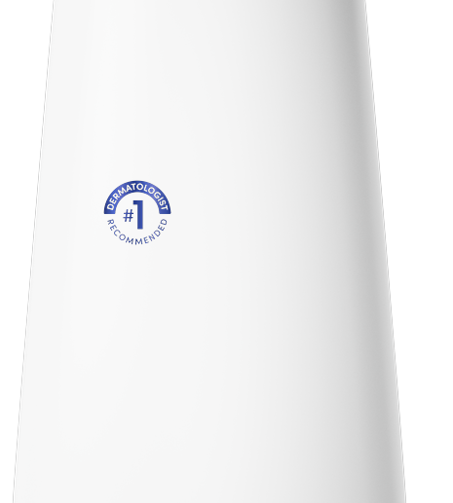
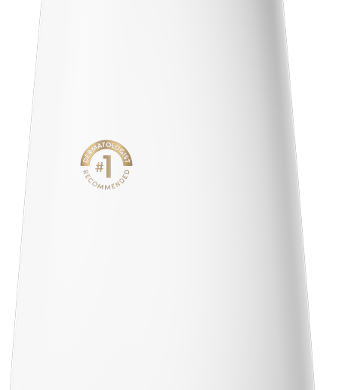
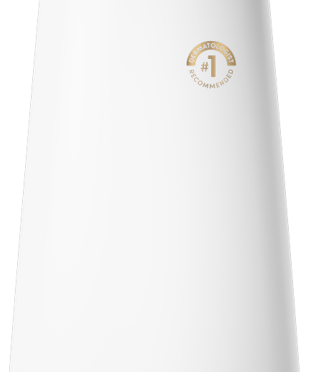
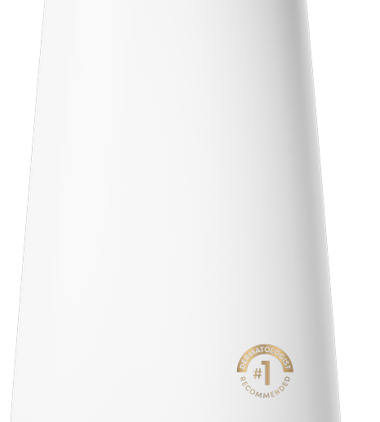
ELEMENT WINNERS: DERM SEAL · 1 of 2
Derm Seal Variant Top Left leads in both groups
Derm Seal Variant Top Left leads both groups; Derm Seal Gold High ranks last.
DERM SEAL
Derm Seal Variant
Top Left
+15
+20
Derm Seal Variant
Top Left
Derm Seal Gold Top
Left
Derm Seal Gold Top
Left
+13
+18*
+16*
+18
Derm Seal Gold
Std
+6
+11
Derm Seal Gold Low
Right
+7
+10
Derm Seal Gold Std
Derm Seal Gold Low
Right
0
5
10
15
20
+8*
+8*
Non-users (basesize = 308)
Dove users (basesize = 293)
Both groups rank Derm Seal Variant Top Left first. The widest segment gap is Derm Seal Variant Std: +4 non-users / +10 users.
Non-users basesize = 308; Dove users basesize = 293. Top-2 scores rounded to whole points. *Average of the groups in the legend.
28

Slide 29
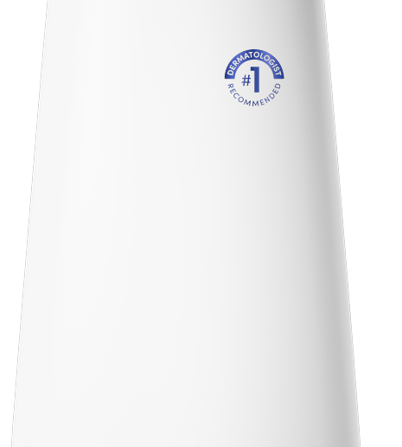
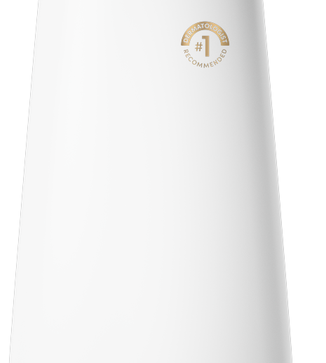
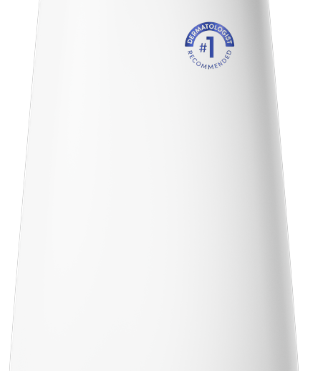
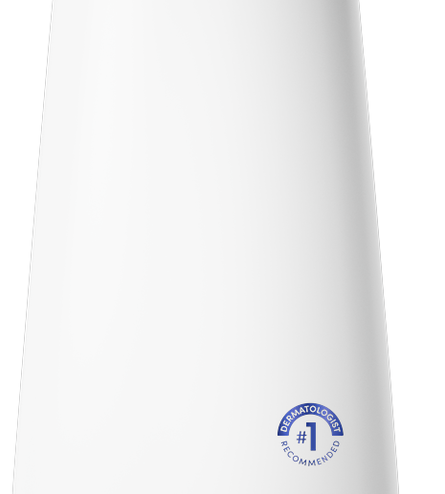
ELEMENT WINNERS: DERM SEAL · 2 of 2
Derm Seal Variant Top Left leads in both groups
Derm Seal Variant Top Left leads both groups; Derm Seal Gold High ranks last.
DERM SEAL
Derm Seal Variant
Std
+4
+10
Derm Seal Variant
Std
Derm Seal Gold High
Derm Seal Gold
High
+5
+7*
+7*
+9
Derm Seal Variant
High
+7
+9
Derm Seal Variant
Low Right
+6
+9
Derm Seal Variant
High
Derm Seal Variant
Low Right
0
5
10
+8*
+8*
Non-users (basesize = 308)
Dove users (basesize = 293)
Both groups rank Derm Seal Variant Top Left first. The widest segment gap is Derm Seal Variant Std: +4 non-users / +10 users.
Non-users basesize = 308; Dove users basesize = 293. Top-2 scores rounded to whole points. *Average of the groups in the legend.
29

Slide 30
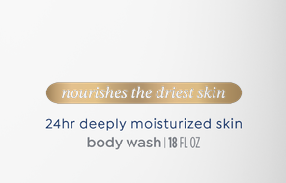
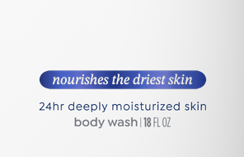
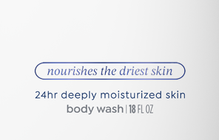
ELEMENT WINNERS: LOZ LOW CTR · 1 of 2
Loz Low Ctr splits across the groups
Non-users favor Loz Gold Outline Low Ctr; Dove users favor Loz Gold Fill Low Ctr.
LOZ LOW CTR
Loz Gold Fill Low Ctr
+17*
Loz Gold Fill Low
Ctr
+12
+22
Loz Variant Fill
Low Ctr
+12
Loz Variant Fill Low Ctr
+18
+15*
Loz Variant
Outline Low Ctr
+10
+18
Loz Variant Outline Low Ctr
0
10
20
30
+14*
Non-users (basesize = 308)
Dove users (basesize = 293)
Non-users favor Loz Gold Outline Low Ctr; Dove users favor Loz Gold Fill Low Ctr. The widest segment gap is Loz Gold Fill Low Ctr: +12 non-users / +22 users.
Non-users basesize = 308; Dove users basesize = 293. Top-2 scores rounded to whole points. *Average of the groups in the legend.
30

Slide 31
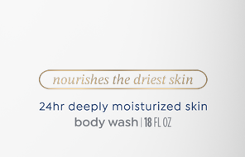
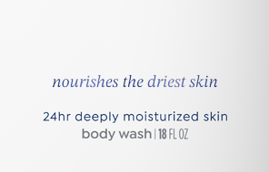
ELEMENT WINNERS: LOZ LOW CTR · 2 of 2
Loz Low Ctr splits across the groups
Non-users favor Loz Gold Outline Low Ctr; Dove users favor Loz Gold Fill Low Ctr.
LOZ LOW CTR
Loz Gold Outline
Low Ctr
+13
+17
Loz Gold Outline
Low Ctr
Loz Text Low Ctr
+15*
+14*
Loz Text Low Ctr
+11
+17
0
5
10
15
20
Non-users (basesize = 308)
Dove users (basesize = 293)
Non-users favor Loz Gold Outline Low Ctr; Dove users favor Loz Gold Fill Low Ctr. The widest segment gap is Loz Gold Fill Low Ctr: +12 non-users / +22 users.
Non-users basesize = 308; Dove users basesize = 293. Top-2 scores rounded to whole points. *Average of the groups in the legend.
31

Slide 32
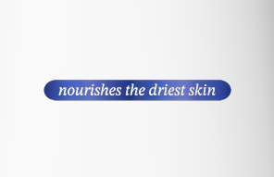

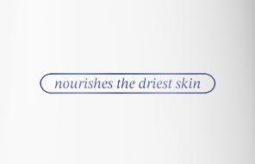
ELEMENT WINNERS: LOZ TOP CTR LOW · 1 of 2
Loz Top Ctr Low splits across the groups
Non-users favor Loz Gold Outline Top Ctr Low; Dove users favor Loz Variant Fill Top Ctr Low.
LOZ TOP CTR LOW
Loz Variant Fill Top Ctr Low
+22*
Loz Variant Fill
Top Ctr Low
+16
+27
Loz Gold Fill Top
Ctr Low
+17
Loz Gold Fill Top Ctr Low
+26
+22*
Loz Variant
Outline Top Ctr…
+16
+26
Loz Variant Outline Top Ctr Low
0
10
20
30
40
+21*
Non-users (basesize = 308)
Dove users (basesize = 293)
Non-users favor Loz Gold Outline Top Ctr Low; Dove users favor Loz Variant Fill Top Ctr Low. The widest segment gap is Loz Variant Fill Top Ctr Low: +16 non-users / +27 users.
Non-users basesize = 308; Dove users basesize = 293. Top-2 scores rounded to whole points. *Average of the groups in the legend.
32

Slide 33
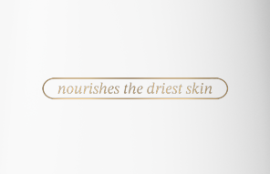
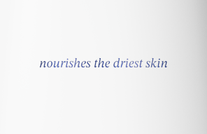
ELEMENT WINNERS: LOZ TOP CTR LOW · 2 of 2
Loz Top Ctr Low splits across the groups
Non-users favor Loz Gold Outline Top Ctr Low; Dove users favor Loz Variant Fill Top Ctr Low.
LOZ TOP CTR LOW
Loz Gold Outline
Top Ctr Low
+19
+25
Loz Gold Outline
Top Ctr Low
Loz Text Top Ctr
Low
+22*
+20*
Loz Text Top Ctr
Low
+16
+23
0
10
20
30
40
Non-users (basesize = 308)
Dove users (basesize = 293)
Non-users favor Loz Gold Outline Top Ctr Low; Dove users favor Loz Variant Fill Top Ctr Low. The widest segment gap is Loz Variant Fill Top Ctr Low: +16 non-users / +27 users.
Non-users basesize = 308; Dove users basesize = 293. Top-2 scores rounded to whole points. *Average of the groups in the legend.
33

Slide 34
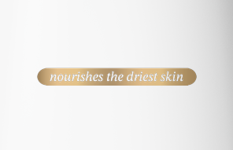


ELEMENT WINNERS: LOZ TOP CTR · 1 of 2
Loz Gold Fill Top Ctr leads in both groups
Loz Gold Fill Top Ctr leads both groups; Loz Variant Fill Top Ctr ranks last.
LOZ TOP CTR
Loz Gold Fill Top Ctr
+24*
Loz Gold Fill Top
Ctr
+20
+29
Loz Text Top Ctr
+16
Loz Text Top Ctr
+27
+22*
Loz Gold Outline
Top Ctr
+16
+26
Loz Gold Outline Top Ctr
0
10
20
30
40
+21*
Non-users (basesize = 308)
Dove users (basesize = 293)
Both groups rank Loz Gold Fill Top Ctr first. The widest segment gap is Loz Text Top Ctr: +16 non-users / +27 users.
Non-users basesize = 308; Dove users basesize = 293. Top-2 scores rounded to whole points. *Average of the groups in the legend.
34

Slide 35


ELEMENT WINNERS: LOZ TOP CTR · 2 of 2
Loz Gold Fill Top Ctr leads in both groups
Loz Gold Fill Top Ctr leads both groups; Loz Variant Fill Top Ctr ranks last.
LOZ TOP CTR
Loz Variant
Outline Top Ctr
+16
+26
Loz Variant Outline
Top Ctr
Loz Variant Fill
Top Ctr
+21*
+20*
Loz Variant Fill
Top Ctr
+16
+25
0
10
20
30
40
Non-users (basesize = 308)
Dove users (basesize = 293)
Both groups rank Loz Gold Fill Top Ctr first. The widest segment gap is Loz Text Top Ctr: +16 non-users / +27 users.
Non-users basesize = 308; Dove users basesize = 293. Top-2 scores rounded to whole points. *Average of the groups in the legend.
35

Slide 36



ELEMENT WINNERS: LOZ TOP LEFT LOW · 1 of 2
Loz Variant Fill Top Left Low leads in both groups
Loz Variant Fill Top Left Low leads both groups; Loz Text Top Left Low ranks last.
LOZ TOP LEFT LOW
Loz Variant Fill Top Left Low
+25*
Loz Variant Fill
Top Left Low
+19
+31
Loz Gold Outline
Top Left Low
+16
Loz Gold Outline Top Left Low
+28
+22*
Loz Variant
Outline Top Left…
+16
+27
Loz Variant Outline Top Left Low
0
10
20
30
40
+22*
Non-users (basesize = 308)
Dove users (basesize = 293)
Both groups rank Loz Variant Fill Top Left Low first. The widest segment gap is Loz Variant Fill Top Left Low: +19 non-users / +31 users.
Non-users basesize = 308; Dove users basesize = 293. Top-2 scores rounded to whole points. *Average of the groups in the legend.
36

Slide 37


ELEMENT WINNERS: LOZ TOP LEFT LOW · 2 of 2
Loz Variant Fill Top Left Low leads in both groups
Loz Variant Fill Top Left Low leads both groups; Loz Text Top Left Low ranks last.
LOZ TOP LEFT LOW
Loz Gold Fill Top
Left Low
+18
+25
Loz Gold Fill Top
Left Low
Loz Text Top Left
Low
+22*
+20*
Loz Text Top Left
Low
+17
+24
0
10
20
30
40
Non-users (basesize = 308)
Dove users (basesize = 293)
Both groups rank Loz Variant Fill Top Left Low first. The widest segment gap is Loz Variant Fill Top Left Low: +19 non-users / +31 users.
Non-users basesize = 308; Dove users basesize = 293. Top-2 scores rounded to whole points. *Average of the groups in the legend.
37

Slide 38



ELEMENT WINNERS: LOZ TOP LEFT · 1 of 2
Loz Top Left splits across the groups
Non-users favor Loz Gold Outline Top Left; Dove users favor Loz Text Top Left.
LOZ TOP LEFT
Loz Text Top Left
+22*
Loz Text Top
Left
+16
+27
Loz Variant Fill
Top Left
+15
Loz Variant Fill Top Left
+27
+21*
Loz Gold Outline
Top Left
+19
+27
Loz Gold Outline Top Left
0
10
20
30
40
+23*
Non-users (basesize = 308)
Dove users (basesize = 293)
Non-users favor Loz Gold Outline Top Left; Dove users favor Loz Text Top Left. The widest segment gap is Loz Variant Outline Top Left: +13 non-users / +26 users.
Non-users basesize = 308; Dove users basesize = 293. Top-2 scores rounded to whole points. *Average of the groups in the legend.
38

Slide 39


ELEMENT WINNERS: LOZ TOP LEFT · 2 of 2
Loz Top Left splits across the groups
Non-users favor Loz Gold Outline Top Left; Dove users favor Loz Text Top Left.
LOZ TOP LEFT
Loz Gold Fill Top
Left
+16
+26
Loz Gold Fill Top
Left
Loz Variant Outline
Top Left
+21*
+20*
Loz Variant
Outline Top Left
+13
+26
0
10
20
30
40
Non-users (basesize = 308)
Dove users (basesize = 293)
Non-users favor Loz Gold Outline Top Left; Dove users favor Loz Text Top Left. The widest segment gap is Loz Variant Outline Top Left: +13 non-users / +26 users.
Non-users basesize = 308; Dove users basesize = 293. Top-2 scores rounded to whole points. *Average of the groups in the legend.
39

Slide 40




ELEMENT WINNERS: ADVANCED CARE
Advanced Care splits across the groups
Non-users favor Adv Care Lowercase No Wordmark; Dove users favor Adv Care Caps No Wordmark.
ADVANCED CARE
Adv Care Caps No
Wordmark
+3
Adv Care Caps No
Wordmark
Adv Care Caps Under
Logo
+8
+6*
+6*
Adv Care Caps
Under Logo
+4
+8
Adv Care Lowercase
No Wordmark
+5
+7
Adv Care Lowercase
Under Logo
+4
Adv Care Lowercase
No Wordmark
Adv Care Lowercase
Under Logo
+7
+6*
+6*
0
5
10
Non-users (basesize = 308)
Dove users (basesize = 293)
Non-users favor Adv Care Lowercase No Wordmark; Dove users favor Adv Care Caps No Wordmark. The widest segment gap is Adv Care Caps No Wordmark: +3 non-users / +8 users.
Non-users basesize = 308; Dove users basesize = 293. Top-2 scores rounded to whole points. *Average of the groups in the legend.
40

Slide 41




ELEMENT WINNERS: WORDMARK
Wordmark 100% leads in both groups
Wordmark 100% leads both groups; Wordmark Grey ranks last.
WORDMARK
Wordmark 100%
+11
Wordmark 100%
Wordmark 60%
+18
+14*
+12*
Wordmark 60%
+9
+14
Wordmark 75%
+8
+14
Wordmark Grey
+4
Wordmark 75%
Wordmark Grey
+9
+11*
+6*
0
5
10
15
20
Non-users (basesize = 308)
Dove users (basesize = 293)
Both groups rank Wordmark 100% first. The widest segment gap is Wordmark 100%: +11 non-users / +18 users.
Non-users basesize = 308; Dove users basesize = 293. Top-2 scores rounded to whole points. *Average of the groups in the legend.
41

Slide 42




ELEMENT WINNERS: BIRD TREATMENT
Bird Treatment splits across the groups
Non-users favor Bird Variant Gravure; Dove users favor Bird Gold Cold Foil.
BIRD TREATMENT
Bird Gold Cold
Foil
+6
+9
Bird Gold Cold Foil
Bird Gold Gravure
Bird Gold
Gravure
+6
+8*
+8*
+9
Bird Holo Foil
+6
+9
Bird Variant
Gravure
+7
+8
Bird Holo Foil
Bird Variant
Gravure
0
5
10
+8*
+8*
Non-users (basesize = 308)
Dove users (basesize = 293)
Non-users favor Bird Variant Gravure; Dove users favor Bird Gold Cold Foil. The widest segment gap is Bird Gold Cold Foil: +6 non-users / +9 users.
Non-users basesize = 308; Dove users basesize = 293. Top-2 scores rounded to whole points. *Average of the groups in the legend.
42

Slide 43



ELEMENT WINNERS: GOLD FOIL BAND
Gold Band On leads in both groups
Gold Band On leads both groups; Gold Band Off ranks last.
GOLD FOIL BAND
Gold Band On
+4*
Gold Band On
+3
+4
Gold Band Blue
+2
Gold Band Blue
+4
+3*
Gold Band Off
0
+3
0
1
2
3
4
Gold Band Off
+2*
Non-users (basesize = 308)
Dove users (basesize = 293)
Both groups rank Gold Band On first. The widest segment gap is Gold Band Off: 0 non-users / +3 users.
Non-users basesize = 308; Dove users basesize = 293. Top-2 scores rounded to whole points. *Average of the groups in the legend.
43

Slide 44



ELEMENT WINNERS: CAP COLOR
Cap Pearl White leads in both groups
Cap Pearl White leads both groups; Cap Gold ranks last.
CAP COLOR
Cap Pearl White
+4*
Cap Pearl White
+3
+5
Cap Variant
Match
+3
Cap Variant Match
+4
+4*
Cap Gold
+2
+3
0
2
4
Cap Gold
+2*
Non-users (basesize = 308)
Dove users (basesize = 293)
Both groups rank Cap Pearl White first. The widest segment gap is Cap Pearl White: +3 non-users / +5 users.
Non-users basesize = 308; Dove users basesize = 293. Top-2 scores rounded to whole points. *Average of the groups in the legend.
44

Slide 45
Appendix

Slide 46
APPENDIX · FULL ELEMENT LIFT SUMMARY
Every element, one silo per page
Scores are Top-2 Box coefficients (ratings 4–5), rounded the same way as the charts. Green is lift above the baseline. Red is lift below it. Overall is the full sample. The other columns are Non-users, Dove users.
No intercept
14
69
Base appeal
Silos in the tables
Elements scored
n=308 Non-users; n=293 Dove users. Top-2 Box model: element lifts show movement above or below the model baseline. Values rounded to whole points.
46

Slide 47
FULL ELEMENT LIFT SUMMARY
Deboss — Element Lift Summary
Deboss Blue leads both groups; Deboss Off ranks last.
DEBOSS
Element
Overall
Non-users
Dove users
Deboss Blue
+7
+5
+10
Deboss On
+3
+3
+4
Deboss Off
+1
+1
+2
n=308 Non-users; n=293 Dove users. Top-2 Box model: element lifts show movement above or below the model baseline. Values rounded to whole points.
47

Slide 48
FULL ELEMENT LIFT SUMMARY
Imagery — Element Lift Summary
Splash High leads both groups; Swipe Low ranks last.
IMAGERY
Element
Overall
Non-users
Dove users
Splash High
+24
+20
+27
Dollop High
+21
+17
+25
Dollop Standard
+20
+18
+21
Splash Standard
+19
+18
+20
Swipe High
+19
+14
+24
Splash Low
+14
+13
+14
Swipe Standard
+13
+11
+15
Dollop Low
+12
+9
+14
Swipe Low
+8
+8
+9
n=308 Non-users; n=293 Dove users. Top-2 Box model: element lifts show movement above or below the model baseline. Values rounded to whole points.
48

Slide 49
FULL ELEMENT LIFT SUMMARY
Variant — Element Lift Summary
Non-users favor Variant Left Low; Dove users favor Variant Ctr Low.
VARIANT
Element
Overall
Non-users
Dove users
Variant Ctr Low
+29
+25
+34
Variant Left Low
+28
+27
+30
Variant Ctr Top Lowered
+21
+22
+20
Variant Left Top
+19
+18
+19
Variant Ctr Top
+19
+20
+18
Variant Left Top Lowered
+18
+19
+18
n=308 Non-users; n=293 Dove users. Top-2 Box model: element lifts show movement above or below the model baseline. Values rounded to whole points.
49

Slide 50
FULL ELEMENT LIFT SUMMARY
Derm Seal — Element Lift Summary
Derm Seal Variant Top Left leads both groups; Derm Seal Gold High ranks last.
DERM SEAL
Element
Overall
Non-users
Dove users
Derm Seal Variant Top Left
+18
+15
+20
Derm Seal Gold Top Left
+16
+13
+18
Derm Seal Gold Low Right
+9
+7
+10
Derm Seal Gold Std
+8
+6
+11
Derm Seal Variant High
+8
+7
+9
Derm Seal Variant Low Right
+8
+6
+9
Derm Seal Gold High
+7
+5
+9
Derm Seal Variant Std
+7
+4
+10
n=308 Non-users; n=293 Dove users. Top-2 Box model: element lifts show movement above or below the model baseline. Values rounded to whole points.
50

Slide 51
FULL ELEMENT LIFT SUMMARY
Loz Low Ctr — Element Lift Summary
Non-users favor Loz Gold Outline Low Ctr; Dove users favor Loz Gold Fill Low Ctr.
LOZ LOW CTR
Element
Overall
Non-users
Dove users
Loz Gold Fill Low Ctr
+17
+12
+22
Loz Variant Fill Low Ctr
+15
+12
+18
Loz Gold Outline Low Ctr
+15
+13
+17
Loz Variant Outline Low Ctr
+14
+10
+18
Loz Text Low Ctr
+14
+11
+17
n=308 Non-users; n=293 Dove users. Top-2 Box model: element lifts show movement above or below the model baseline. Values rounded to whole points.
51

Slide 52
FULL ELEMENT LIFT SUMMARY
Loz Top Ctr Low — Element Lift Summary
Non-users favor Loz Gold Outline Top Ctr Low; Dove users favor Loz Variant Fill Top Ctr Low.
LOZ TOP CTR LOW
Element
Overall
Non-users
Dove users
Loz Gold Outline Top Ctr Low
+22
+19
+25
Loz Gold Fill Top Ctr Low
+21
+17
+26
Loz Variant Fill Top Ctr Low
+21
+16
+27
Loz Variant Outline Top Ctr Low
+21
+16
+26
Loz Text Top Ctr Low
+19
+16
+23
n=308 Non-users; n=293 Dove users. Top-2 Box model: element lifts show movement above or below the model baseline. Values rounded to whole points.
52

Slide 53
FULL ELEMENT LIFT SUMMARY
Loz Top Ctr — Element Lift Summary
Loz Gold Fill Top Ctr leads both groups; Loz Variant Fill Top Ctr ranks last.
LOZ TOP CTR
Element
Overall
Non-users
Dove users
Loz Gold Fill Top Ctr
+24
+20
+29
Loz Text Top Ctr
+22
+16
+27
Loz Gold Outline Top Ctr
+21
+16
+26
Loz Variant Outline Top Ctr
+21
+16
+26
Loz Variant Fill Top Ctr
+20
+16
+25
n=308 Non-users; n=293 Dove users. Top-2 Box model: element lifts show movement above or below the model baseline. Values rounded to whole points.
53

Slide 54
FULL ELEMENT LIFT SUMMARY
Loz Top Left Low — Element Lift Summary
Loz Variant Fill Top Left Low leads both groups; Loz Text Top Left Low ranks last.
LOZ TOP LEFT LOW
Element
Overall
Non-users
Dove users
Loz Variant Fill Top Left Low
+25
+19
+31
Loz Gold Outline Top Left Low
+22
+16
+28
Loz Variant Outline Top Left Low
+21
+16
+27
Loz Gold Fill Top Left Low
+21
+18
+25
Loz Text Top Left Low
+20
+17
+24
n=308 Non-users; n=293 Dove users. Top-2 Box model: element lifts show movement above or below the model baseline. Values rounded to whole points.
54

Slide 55
FULL ELEMENT LIFT SUMMARY
Loz Top Left — Element Lift Summary
Non-users favor Loz Gold Outline Top Left; Dove users favor Loz Text Top Left.
LOZ TOP LEFT
Element
Overall
Non-users
Dove users
Loz Gold Outline Top Left
+23
+19
+27
Loz Text Top Left
+21
+16
+27
Loz Gold Fill Top Left
+21
+16
+26
Loz Variant Fill Top Left
+21
+15
+27
Loz Variant Outline Top Left
+20
+13
+26
n=308 Non-users; n=293 Dove users. Top-2 Box model: element lifts show movement above or below the model baseline. Values rounded to whole points.
55

Slide 56
FULL ELEMENT LIFT SUMMARY
Advanced Care — Element Lift Summary
Non-users favor Adv Care Lowercase No Wordmark; Dove users favor Adv Care Caps No Wordmark.
ADVANCED CARE
Element
Overall
Non-users
Dove users
Adv Care Caps No Wordmark
+6
+3
+8
Adv Care Caps Under Logo
+6
+4
+8
Adv Care Lowercase No Wordmark
+6
+5
+7
Adv Care Lowercase Under Logo
+5
+4
+7
n=308 Non-users; n=293 Dove users. Top-2 Box model: element lifts show movement above or below the model baseline. Values rounded to whole points.
56

Slide 57
FULL ELEMENT LIFT SUMMARY
Wordmark — Element Lift Summary
Wordmark 100% leads both groups; Wordmark Grey ranks last.
WORDMARK
Element
Overall
Non-users
Dove users
Wordmark 100%
+14
+11
+18
Wordmark 60%
+12
+9
+14
Wordmark 75%
+11
+8
+14
Wordmark Grey
+6
+4
+9
n=308 Non-users; n=293 Dove users. Top-2 Box model: element lifts show movement above or below the model baseline. Values rounded to whole points.
57

Slide 58
FULL ELEMENT LIFT SUMMARY
Bird Treatment — Element Lift Summary
Non-users favor Bird Variant Gravure; Dove users favor Bird Gold Cold Foil.
BIRD TREATMENT
Element
Overall
Non-users
Dove users
Bird Gold Cold Foil
+7
+6
+9
Bird Gold Gravure
+7
+6
+9
Bird Holo Foil
+7
+6
+9
Bird Variant Gravure
+7
+7
+8
n=308 Non-users; n=293 Dove users. Top-2 Box model: element lifts show movement above or below the model baseline. Values rounded to whole points.
58

Slide 59
FULL ELEMENT LIFT SUMMARY
Gold Foil Band — Element Lift Summary
Gold Band On leads both groups; Gold Band Off ranks last.
GOLD FOIL BAND
Element
Overall
Non-users
Dove users
Gold Band On
+3
+3
+4
Gold Band Blue
+3
+2
+4
Gold Band Off
+1
0
+3
n=308 Non-users; n=293 Dove users. Top-2 Box model: element lifts show movement above or below the model baseline. Values rounded to whole points.
59

Slide 60
FULL ELEMENT LIFT SUMMARY
Cap Color — Element Lift Summary
Cap Pearl White leads both groups; Cap Gold ranks last.
CAP COLOR
Element
Overall
Non-users
Dove users
Cap Pearl White
+4
+3
+5
Cap Variant Match
+3
+3
+4
Cap Gold
+2
+2
+3
n=308 Non-users; n=293 Dove users. Top-2 Box model: element lifts show movement above or below the model baseline. Values rounded to whole points.
60

Slide 61
Element Assets

Slide 62


ELEMENT ASSETS
Deboss — element assets
A · 3 variations
Deboss Off
Deboss Blue
Deboss On
n=601 respondents. Top-2 Box model (ratings 4–5): element lifts show movement above or below the model baseline.
62

Slide 63








ELEMENT ASSETS
Imagery — element assets
B · 9 variations
Dollop High
Dollop Low
Dollop Standard
Splash High
Splash Low
Splash Standard
Swipe Low
Swipe High
Swipe Standard
n=601 respondents. Top-2 Box model (ratings 4–5): element lifts show movement above or below the model baseline.
63

Slide 64





ELEMENT ASSETS
Variant — element assets
C · 6 variations
Variant Ctr Low
Variant Ctr Top Lowered
Variant Left Low
Variant Left Top Lowered
Variant Left Top
Variant Ctr Top
n=601 respondents. Top-2 Box model (ratings 4–5): element lifts show movement above or below the model baseline.
64

Slide 65







ELEMENT ASSETS
Derm Seal — element assets
D · 8 variations
Derm Seal Gold Std
Derm Seal Gold High
Derm Seal Gold Low Right
Derm Seal Gold Top Left
Derm Seal Variant High
Derm Seal Variant Low
Right
Derm Seal Variant Std
Derm Seal Variant Top Left
n=601 respondents. Top-2 Box model (ratings 4–5): element lifts show movement above or below the model baseline.
65

Slide 66




ELEMENT ASSETS
Loz Low Ctr — element assets
E · 5 variations
Loz Gold Fill Low Ctr
Loz Variant Fill Low Ctr
Loz Gold Outline Low Ctr
Loz Variant Outline Low
Ctr
Loz Text Low Ctr
n=601 respondents. Top-2 Box model (ratings 4–5): element lifts show movement above or below the model baseline.
66

Slide 67




ELEMENT ASSETS
Loz Top Ctr Low — element assets
F · 5 variations
Loz Gold Fill Top Ctr Low
Loz Variant Fill Top Ctr
Low
Loz Gold Outline Top Ctr
Low
Loz Variant Outline Top
Ctr Low
Loz Text Top Ctr Low
n=601 respondents. Top-2 Box model (ratings 4–5): element lifts show movement above or below the model baseline.
67

Slide 68




ELEMENT ASSETS
Loz Top Ctr — element assets
G · 5 variations
Loz Gold Fill Top Ctr
Loz Variant Fill Top Ctr
Loz Gold Outline Top Ctr
Loz Variant Outline Top
Ctr
Loz Text Top Ctr
n=601 respondents. Top-2 Box model (ratings 4–5): element lifts show movement above or below the model baseline.
68

Slide 69




ELEMENT ASSETS
Loz Top Left Low — element assets
H · 5 variations
Loz Variant Fill Top Left
Low
Loz Gold Outline Top Left
Low
Loz Variant Outline Top
Left Low
Loz Text Top Left Low
Loz Gold Fill Top Left Low
n=601 respondents. Top-2 Box model (ratings 4–5): element lifts show movement above or below the model baseline.
69

Slide 70




ELEMENT ASSETS
Loz Top Left — element assets
I · 5 variations
Loz Text Top Left
Loz Gold Fill Top Left
Loz Variant Fill Top Left
Loz Gold Outline Top Left
Loz Variant Outline Top
Left
n=601 respondents. Top-2 Box model (ratings 4–5): element lifts show movement above or below the model baseline.
70

Slide 71



ELEMENT ASSETS
Advanced Care — element assets
J · 4 variations
Adv Care Caps No Wordmark
Adv Care Caps Under Logo
Adv Care Lowercase No
Wordmark
Adv Care Lowercase Under
Logo
n=601 respondents. Top-2 Box model (ratings 4–5): element lifts show movement above or below the model baseline.
71

Slide 72



ELEMENT ASSETS
Wordmark — element assets
K · 4 variations
Wordmark 100%
Wordmark 60%
Wordmark 75%
Wordmark Grey
n=601 respondents. Top-2 Box model (ratings 4–5): element lifts show movement above or below the model baseline.
72

Slide 73



ELEMENT ASSETS
Bird Treatment — element assets
L · 4 variations
Bird Gold Cold Foil
Bird Gold Gravure
Bird Holo Foil
Bird Variant Gravure
n=601 respondents. Top-2 Box model (ratings 4–5): element lifts show movement above or below the model baseline.
73

Slide 74

ELEMENT ASSETS
Gold Foil Band — element assets
M · 3 variations
Gold Band Off
Gold Band On
Gold Band Blue
n=601 respondents. Top-2 Box model (ratings 4–5): element lifts show movement above or below the model baseline.
74

Slide 75


ELEMENT ASSETS
Cap Color — element assets
N · 3 variations
Cap Gold
Cap Pearl White
Cap Variant Match
n=601 respondents. Top-2 Box model (ratings 4–5): element lifts show movement above or below the model baseline.
75

Slide 76
Thank you
We look forward to discussing the full report and next steps.
Dove Core Skin Cleansing Study Live Appeal Report | October 2026
Prepared by: J Brown Fitterman | jbrown@mindgenomicsassociates.com
Mind Genomics Associates, Inc
Dove Core Skin Cleansing Study Live

